Slide 1
GO-FAANG Conference Washington, DC
Dr. David Bailey & Dr. Cindy Bell
October 8, 2015

Slide 2
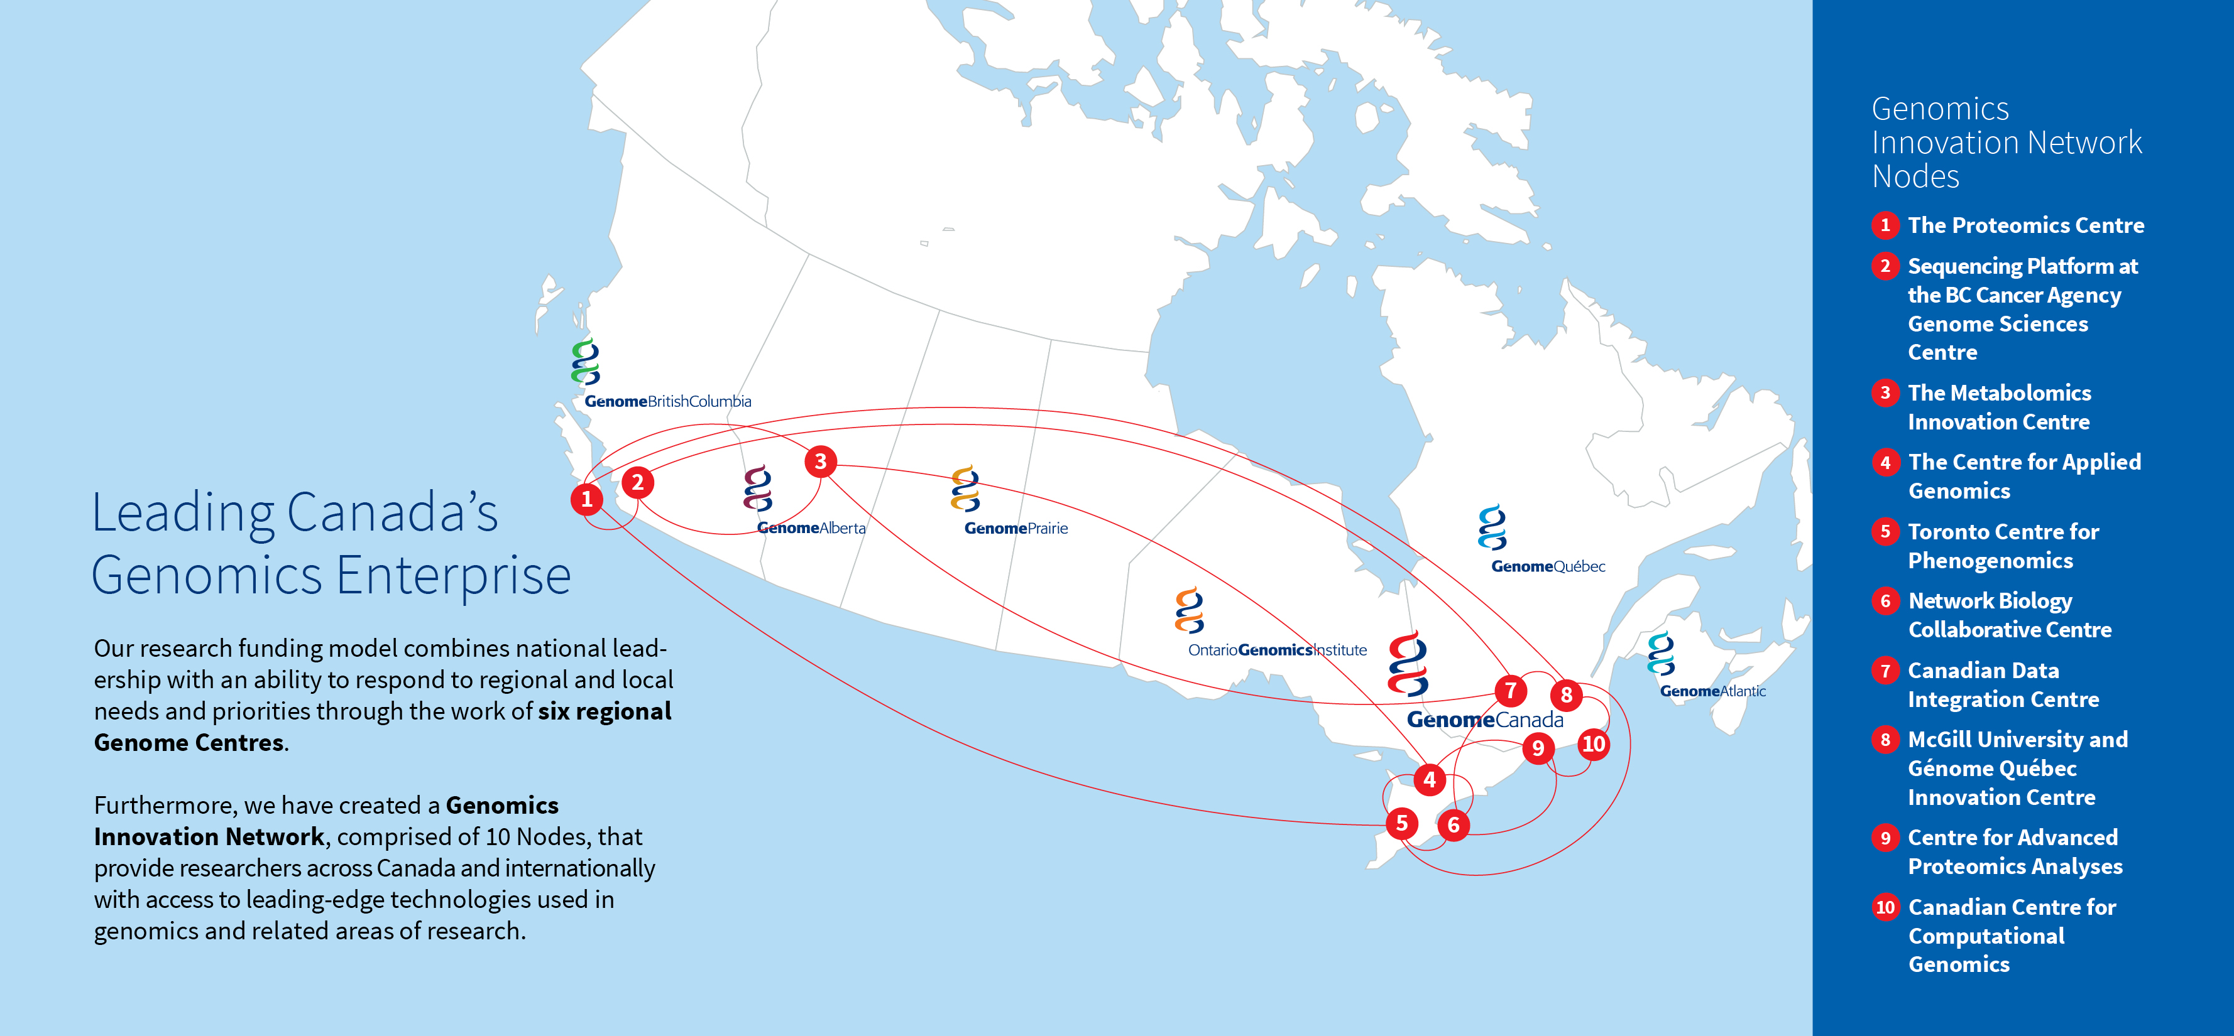
Leading Canada’s genomics enterprise

Slide 3
Genomics offers solutions for sectors vital to our future:
Health, agriculture, forestry, fisheries and aquaculture, the environment, energy, mining—drivers of Canada’s emerging bioeconomy.

Slide 4
Programs that take discoveries from lab to society

Slide 5
Increasing genomics uptake

Slide 6
Genome Canada LSARPs
Previous Campaign:
2012 Genomics and Personalized Health
2014 Genomics and Feeding the Future
2015 Natural Resources and the Environment: Sector Challenges – Genomic Solutions
Next Campaign:
2016 Health
2018 Agriculture/Agri-food and Aquaculture
2019 Natural Resources and the Environment

Slide 7
Genome Canada LSARPs
Goal: Large-scale applied research projects (LSARPS) use genomic approaches to address challenges and opportunities crucial to economic sectors of strategic importance to Canada.
Applicants must demonstrate how their proposal holds a high potential for attaining concrete deliverables by the end of the funding period.
All projects must clearly demonstrate end-user engagement in the development and execution of the research plan in order to help ensure receptor uptake of the research. End-users must be clearly integrated into the project team.

Slide 8
Genome Canada competitions

Slide 9
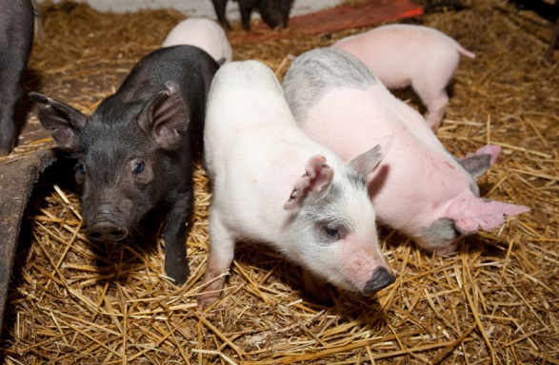
2010 Large-Scale Applied Research Project Competition
Genome Alberta Funded Projects:
Application of Genomics to Improve Swine Health and Welfare
Whole Genome Selection through Genome Wide Imputation in Beef Cattle

Slide 10
Application of Genomics to Improve Swine Health and Welfare
Project Leader(s): Graham Plastow (U of Alberta)
John Harding (U of Saskatchewan)
Bob Kemp (PigGen Canada Inc)
Project Budget: $12,472,751
Project Partners:
Genome Canada
Genome Alberta
Genome Prairie
PigGen Canada
Canadian Swine Health Board
US PRRS Host Genetic Consortium
US Department of Agriculture
Roslin Institute
ALMA
Pork Checkoff

Slide 11
Whole Genome Selection through Genome Wide Imputation in Beef Cattle
Project Leader(s): Paul Stothard (U of Alberta)
Stephen Moore (U of Alberta)
Stephen Miller (U of Guelph)
Project Budget: $8,098,924
Project Partners:
Genome Canada
Genome Alberta
ALMA
AgResearch
CRC Beef
USDA
SEMEX Alliance
Teagasc
SAC
BIO
Western Economic Diversification Canada

Slide 12
2014 LSARP – Genomics and Feeding the Future
Objective:
To support projects that use genomic approaches within the Agri-food sector to address challenges and opportunities related to:
Global Food Safety
Food Security
Sustainable Production
Notes:
Time frame

Slide 13
Lead Genome Centre (Co-lead) | Project | Investigator(s) | Total Budget
Genome BC (GQ) | Enhancing Production in Coho: Culture, Community, Catch (EPIC4) | Willie Davidson, and Louis Bernatchez | $9,867,636
Genome BC (OGI) | Sustaining and Securing Canada’s Honey Bees using ‘omic tools | Leonard Foster, and Amro Zayed | $7,187,318
Genome BC | Genomics of Abiotic Stress Resistance in Wild and Cultivated Sunflowers | Loren Rieseberg, and John Burke | $7,879,009
Genome AB (GP) | Application of Genomics to Improve Disease Resilience and Sustainability in Pork Production | Michael Dyck, John Harding, and Bob Kemp | $9,801,714
Genome AB (OGI) | Increasing Feed Efficiency and Reducing Methane Emissions through Genomics: a new Promising Goal for the Canadian Dairy Industry | Filippo Miglior, and Paul Stothard | $10,306,910
Genome Prairie | Application of Genomics to Innovation in the Lentil Economy (AGILE) | Kristin Bett, and Bert Vandenberg | $8,591,675
Genome Prairie (GBC) | Reverse Vaccinology Approach for the Prevention of Mycobacterial Disease in Cattle | Andy Potter, and Bob Hancock | $7,408,606
Genome Prairie | Canadian Triticum Applied Genomics (CTAG2) | Curtis Pozniak, and Andrew Sharpe | $9,415,985
Ontario Genomics Institute | Towards a Sustainable Fishery for Nunavummiut | Virginia Walker, and Steve Lougheed | $5,563,466
Genome Québec | SoyaGen: Improving Yield and Disease Resistance in Short-Season Soybean | François Belzile, and Richard Bélanger | $8,269,232
Genome Québec | A Syst-OMICS Approach to Ensuring Food Safety and Reducing | Lawrence Goodridge, and Roger Lévesque | $9,769,423
Notes:
PI, title, overall objective, total budget
Time frame

Slide 14
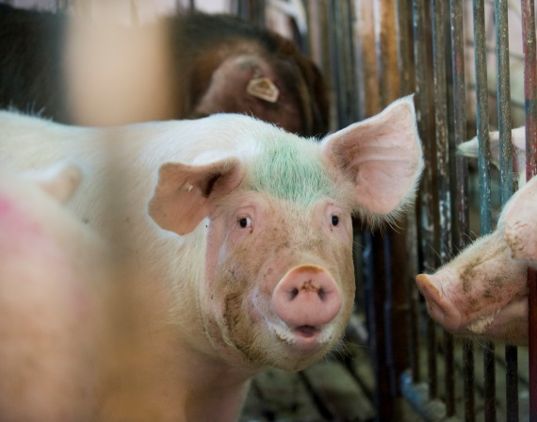
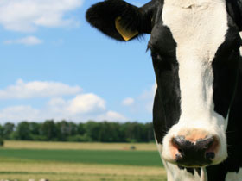
2014 LSARP – Genomics and Feeding the Future
Genome Alberta Funded Projects:
Application of Genomics to Improve Disease Resilience and Sustainability in Pork Production
Increasing Feed Efficiency and Reducing Methane emissions through Genomics: A New Promising Goal for the Canadian Dairy Industry

Slide 15
Application of Genomics to Improve Disease Resilience and Sustainability in Pork Production
Project Leader: Michael Dyck (U of Alberta)
Co-lead Genome Centre: Genome Prairie
Project Budget: $9,801,714
Project Partners:
ALGP2
PigGen Canada
ALMA
Genome Alberta - PEDV
Swine Innovation Pork
Saskatchewan Ministry Agriculture and Food
INRA
National Pork Board
Alltech Inc.
OGI

Slide 16
Increasing Feed Efficiency and Reducing Methane emissions through Genomics: A New Promising Goal for the Canadian Dairy Industry
Project Leader: Filippo Miglior (U of Guelph)
Co-lead Genome Centre: Ontario Genomics Institute
Project Budget: $10,306,910
Project Partners:
Canadian Dairy Network,
Dairy Producers,
GrowSafe System,
Ontario Ministry of Research and Innovation
Australia DEDJTR,
UK Scottish Research College,
USDA Beltsville Research Herd,
Qualitas, Switzerland

Slide 17
Listeria Competition
Application of Genomic Tools to the Detection and Surveillance of Listeria monocytogenes
Objective: support research that will demonstrate how genomics-based research/technologies can contribute to a more evidence-based approach to detection and surveillance of Listeria
Duration: 2013 – 2015
Funding: $250,000 Genome Canada, $250,000 from CFIA, and $100,000 from AI-Bio
Partners: Genome Canada, Canadian Food Inspection Agency (CFIA) and Alberta Innovates – BioSolutions (AI-Bio)

Slide 18
Detection and Surveillance of Listeria monocytogenes using Next-generation genomics tools
Project lead: Dr. Linda Chui (University of Alberta)
Co-leads: Dr. Jian Zhang (AITF), Dr. Franco Pagotto (Health Canada)
Budget: $ 1,461,774.00
Research areas: Listeria monocytogenes, comparative genomics, virulence/biomarkers, rapid detection and monitoring, surveillance and policy
Methodologies: Whole genome sequencing, bioinformatics, rapid detection and genotyping of pathogenic strains, and development of an inexpensive high-throughput test

Slide 19
Genome alberta competitions

Slide 20
Development and Deployment of MBVs/gEPDs for Feed Efficiency and Carcass Traits that Perform in Commercial Beef Cattle
Project Leader: John Basarab (U of Alberta)
Donagh Berry (Teagasc)
John Crowley (U of Alberta)
Project Budget: $4,473,035
Project Partners:
Genome Alberta
ALMA
BIO
Beefbooster Inc.
CCHMS
ICBF
USDA-ARS

Slide 21
Program on Research and Innovation Leading to Rapid Detection of Pathogenic E. coli
Objective:
The main objective of this competition was to develop an innovative genomics based test for the presence of generic and pathogenic E.coli bacteria during food production.
Funding including Partners: $1.8 Million
Duration: 18 months

Slide 22
Program on Research and Innovation Leading to Rapid Detection of Pathogenic E. coli
Title | Investigator(s) | Institution(s) | Total Budget
Point-of-Need Gene-Based System for Detection of Priority STEC in Beef | Michel Bergeron, Burton Blais | Université Laval | $1,032,781
Rapid Sampling and Detection of STEC in Meat | Linda Pilarski, Lynn McMullen | University of Alberta | $726,000
 |  | TOTAL | $1,758,781

Slide 23
Porcine Epidemic Diarrhea Virus (PEDV) Competition
Objective:
This program was created by a consortium of funders intended to respond to the current threat of the PEDv to Canadian pork producers and economy
Funding including partners: $525,000
Duration: 18 months

Slide 24
Porcine Epidemic Diarrhea Virus (PEDV) Competition
Title | Investigator(s) | Institution(s) | Total Budget
Development of a new generation of modified live virus vaccine for PEDv using reverse genetics system | Alexander Zakhartchouk Volker Gerdts | University of Saskatchewan | $347,750
Enhanced molecular diagnostics and validating genetic resistance to PEDv in pigs | John Harding Soren Alexandersen | University of Saskatchewan National Centres for Animal Disease | $325,917
The use of new molecules in association with real time-qPCR assays to discriminate infectious from non-infectious porcine epidemic diarrhea virus (PEDV) particles | Carl Gagnon | Universite de Montreal | $165,000
 |  | TOTAL | $838,667

Slide 25
Applied Livestock Genomics Program 2014 (ALGP2)
Objective: develop projects providing significant benefit to the Canadian livestock industry, and the Canadian economy, through genomics-based innovations.
Duration: January 2015 - January 2018 (max 36 months)
Funding: $1.9 million
Partners: A joint venture between the Alberta Livestock and Meat Agency Ltd. and Genome Alberta

Slide 26
ALGP2
Project | Investigator(s) | ALGP2 Funding Request | Total Budget
Improving Canadian pork industry profits and export potential by developing genomic tools to enhance health, performance and disease resilience in wean to finish pigs | Graham Plastow Bob Kemp | $499,500 | $1,256,500
Genomic approaches to the control of Bovine Respiratory Disease Complex | Graham Plastow Karin Orsel | $499,600 | $1,419,600
Disease reduction in cattle by eliminating colonization of pathogens | Anthony Schryvers Edouard Timsit | $249,404 | $418,404
Validation of Biomarkers for Decreased Salmonella Carriage in Swine | Dan Barreda Ben Willing | $195,969 | $195,969
Incorporating whole genome sequencing and 80K SNP data to enhance genomic prediction for pig feed efficiency | Graham Plastow Bob Kemp | $187,500 | $435,000
Establishment of a reference genomics database for Mycobacterium bovis and Brucella abortus in Wood Buffalo National Park by whole genome sequencing and its use for analysis of local transmission patterns of bovine tuberculosis and brucellosis in this ecosystem | Olga Andrievskaia Susan Nadin-Davis Om Surujballi | $248,000 | $494,000
Total Funding |  | $1,879,973 | $4,219,473

