Slide 1

NIFA’s role in
Catalyzing Transformative Research on
Animal Genome to Phenome
Parag R. Chitnis

Slide 2
NIFA- An Introduction
Lead federal agency providing extramural funding for food and agricultural sciences
Tripartite mission: research, extension, and education
  Funding opportunities exist for each of these three mission areas
NIFA funding
  1.5B budget
  Competitive and capacity funds
Mission
  invest in and advance agricultural research, education, and extension to solve societal challenges.

Slide 3
NIFA funding for
Animal Genomics and Breeding
Farm Animals for Food Production
Aquaculture
Capacity Funds ($9M in 2014)
  Multistate research projects (foster collaborations)
  Hatch Projects (state identified priorities)
AFRI and other competitive programs ($12M in 2014)
  Foundational Grants ($500K)
  Food Security Challenge Area ( > $1 M)
  Aquaculture programs (2-300K)
  Interagency programs

Slide 4
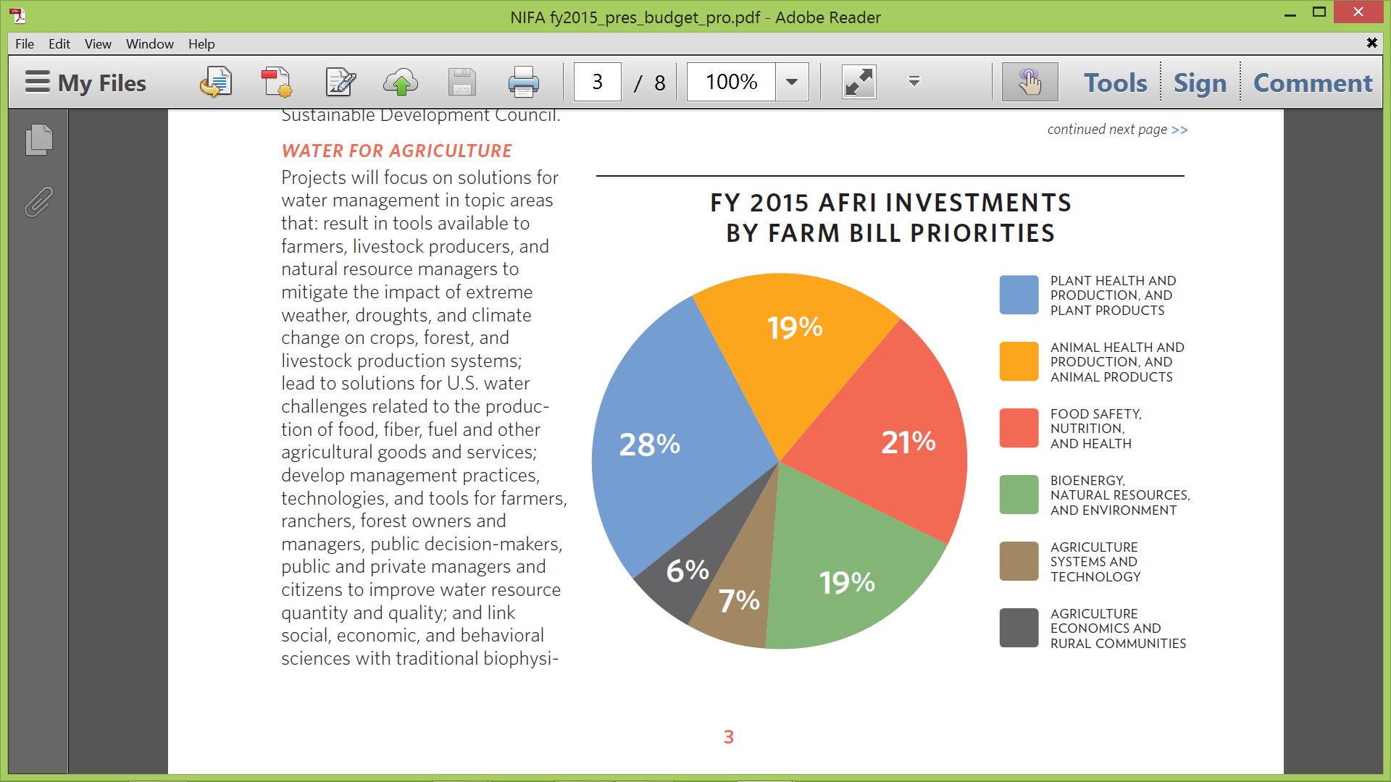
President’s Proposed

Slide 5

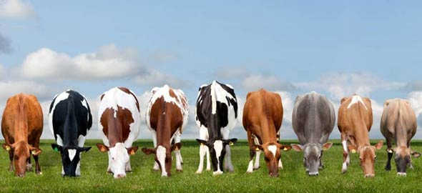
Genome to Phenome: Opportunities
Rules of Life-
Translating genome to
decipher phenome
Applications-
Accelerated and
Predictive Breeding

Slide 6
Genome to Phenome: Challenges
Theoretical underpinning
Technologies
High throughput
phenotyping
Data Resources
Cyberphysical systems
Data Analytics
Predictive algorithms

Slide 7
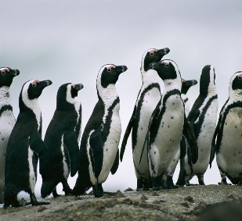
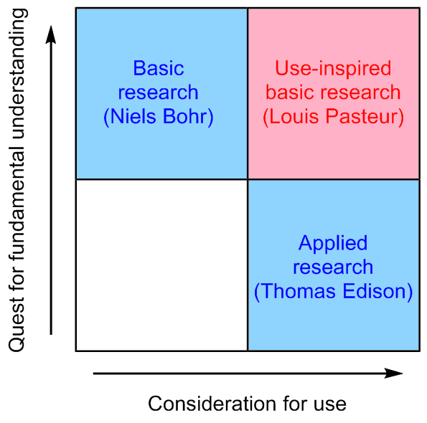

Genome to Phenome:
Interagency Collaboration
NSF
NIFA
NIH
Industry

Slide 8
Learning from other initiatives
Arabidopsis Functional Genomics
  NSF, DFG, BBSRC, and others
National Plant Genome Initiative
  NSF, NIFA, ARS, DOE
Yeast Synthetic Genome
  NSF, China MoST, BBSRC, Singapore, Australia, and others
International Wheat Yield Partnership
  BBSRC, CIMMYT, USAID, NIFA, SAGARPA

Slide 9
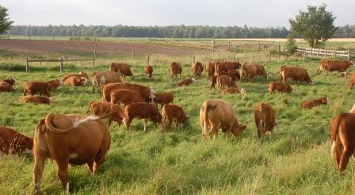
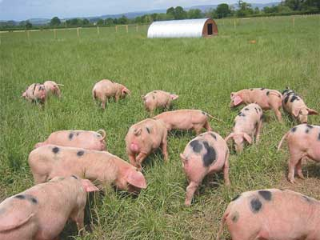
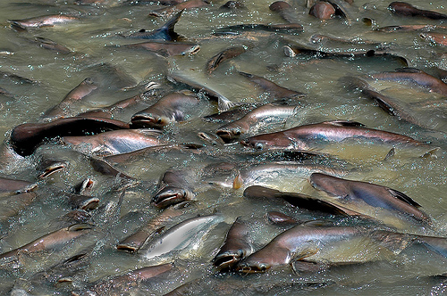
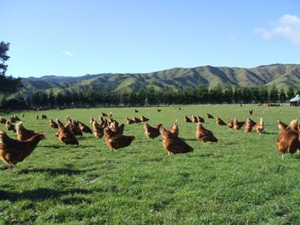
Two cents worth….
Ambitious goals
  Relatable to general public
Clear milestones
  measurable
Economic impacts
  Potential for breakthroughs
Stakeholder buy-in
  Ag. Experiment Stations
  Commodity groups and boards
  Professional Societies

