Slide 1
The Way Forward
Laura Clark, Jiuzhou Song, James Reecy

Slide 2
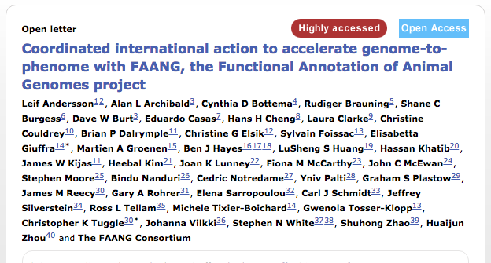
Looking forward for Funding Opportunities?
What is our vision for the future of functional annotation in animal genomes?

Slide 3
What do we need to present?
A Clear Vision
Ambitious Goals
Economic Impact
Stakeholder buy-in
Thanks to Parag Chitnis for putting it so succinctly

Slide 4
International Research Consortium
Common framework with separate sections for researchers and funders addressing various aspects of research, such as
Sharing of data and samples
Rapid release of research results
Common quality standards
Interoperability and harmonisation of ontologies and analysis outcomes
Involvement of the wider scientific community and industry
Concrete outcomes
Paraphrased from Jean-Charles Cavitte slides about IRDIRC

Slide 5
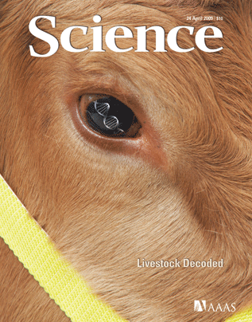
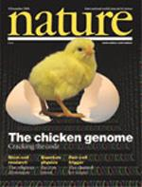
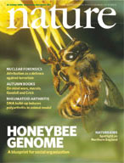
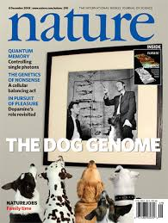
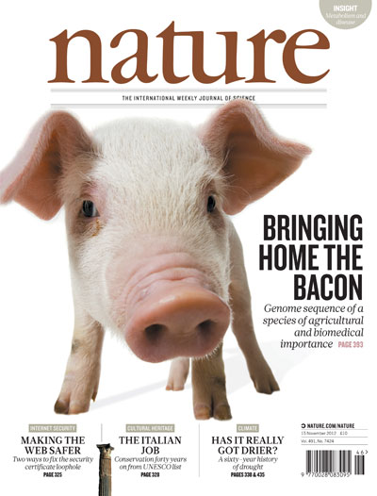

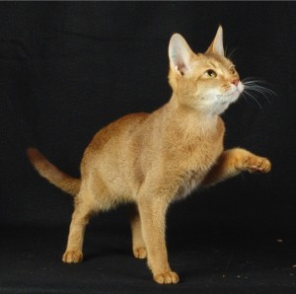
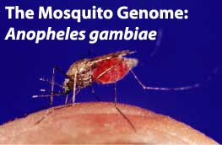
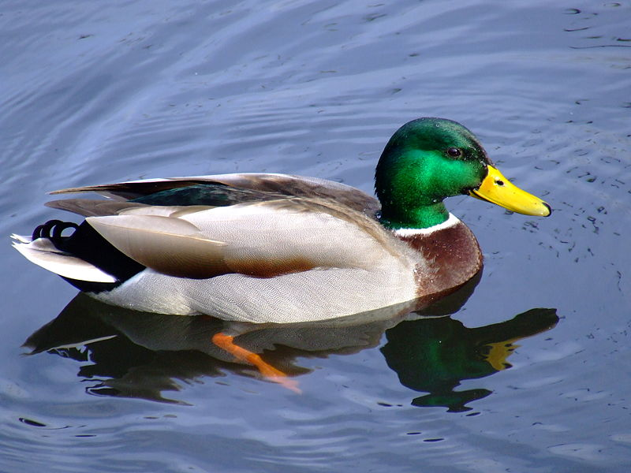
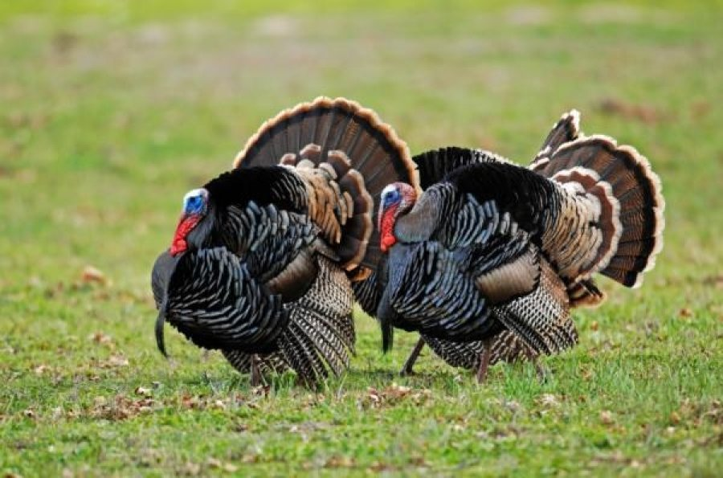
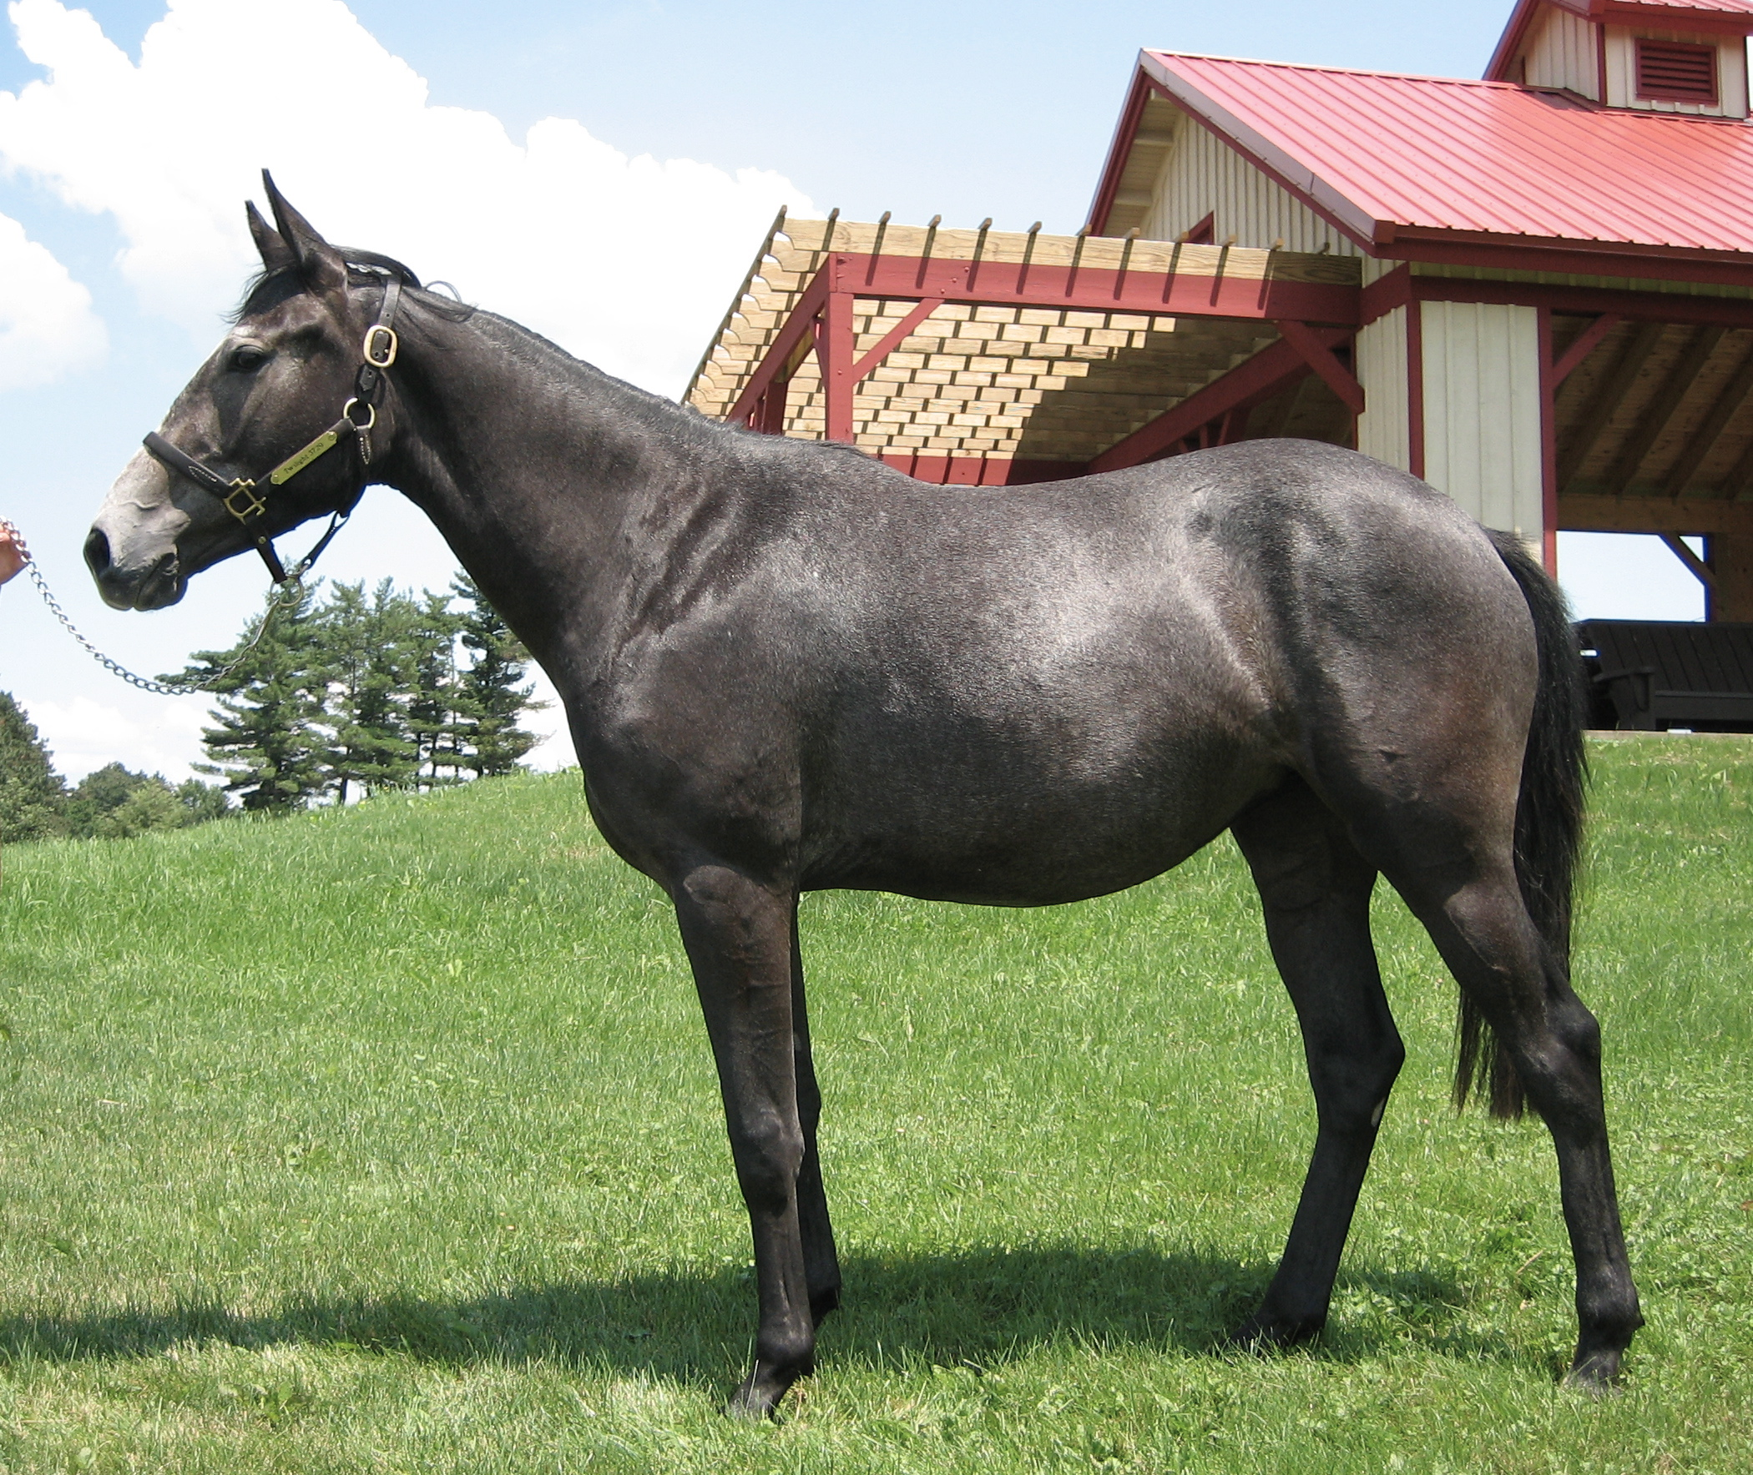
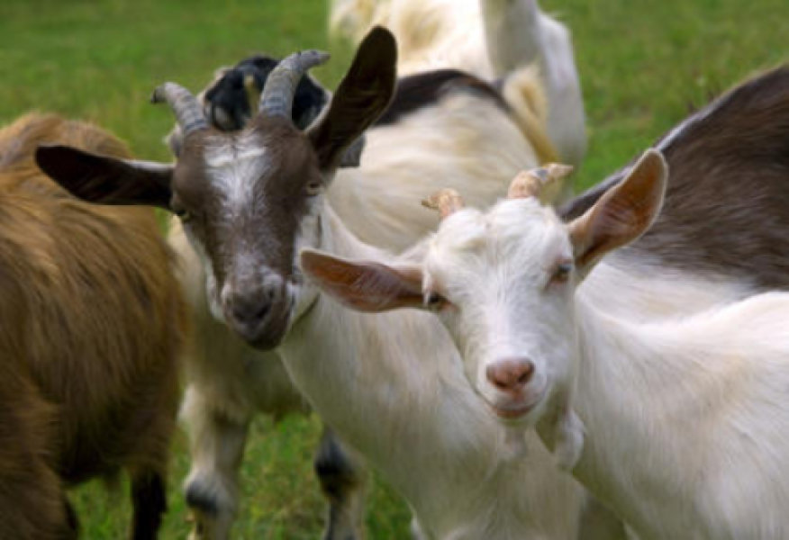

Slide 6


Slide 7
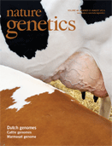
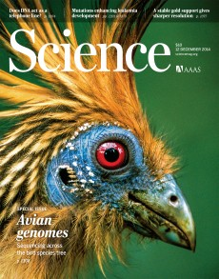
Intra- and Inter-Species Variation

Slide 8
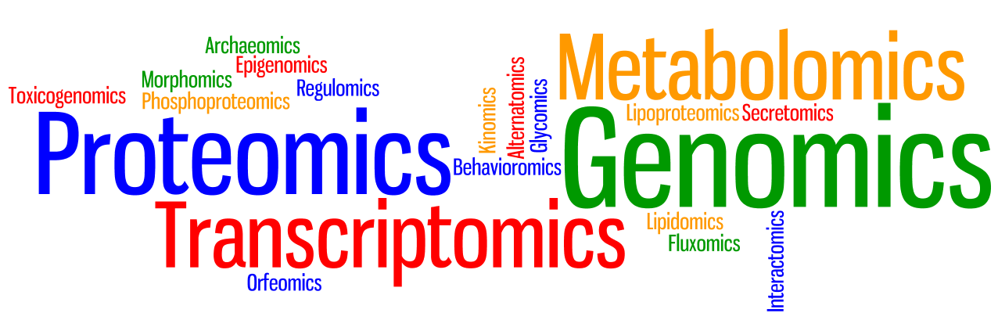
Phenomoics

Slide 9


Slide 10
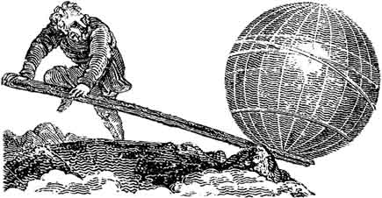

Slide 11


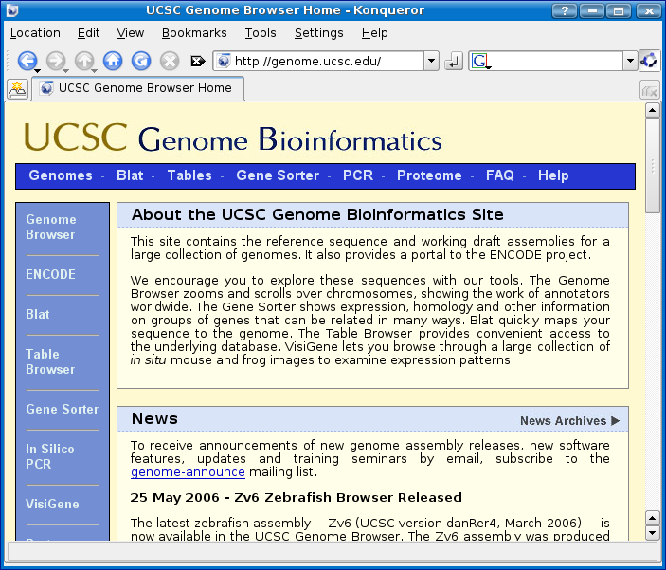


Slide 12
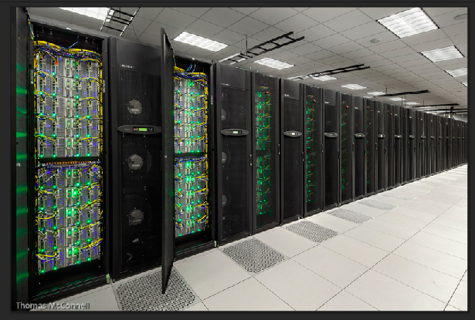


Slide 13


Slide 14
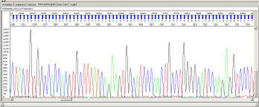
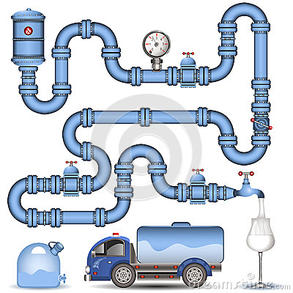
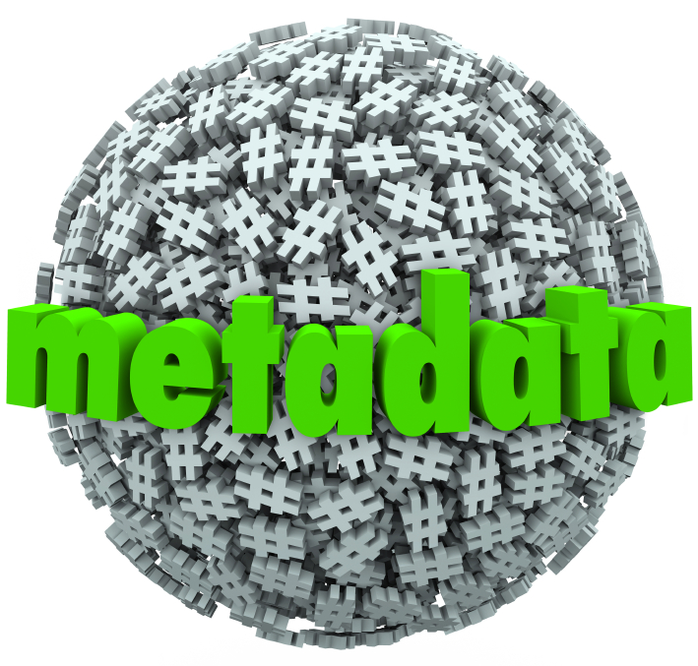


Slide 15
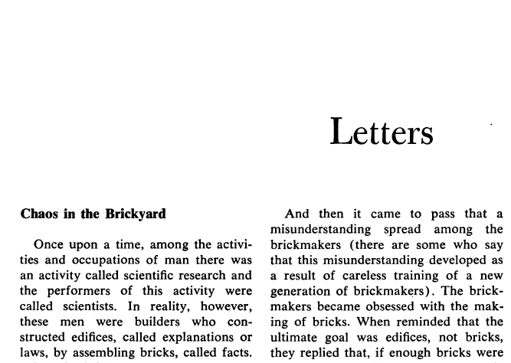
Science Oct. 18, 1963

Slide 16
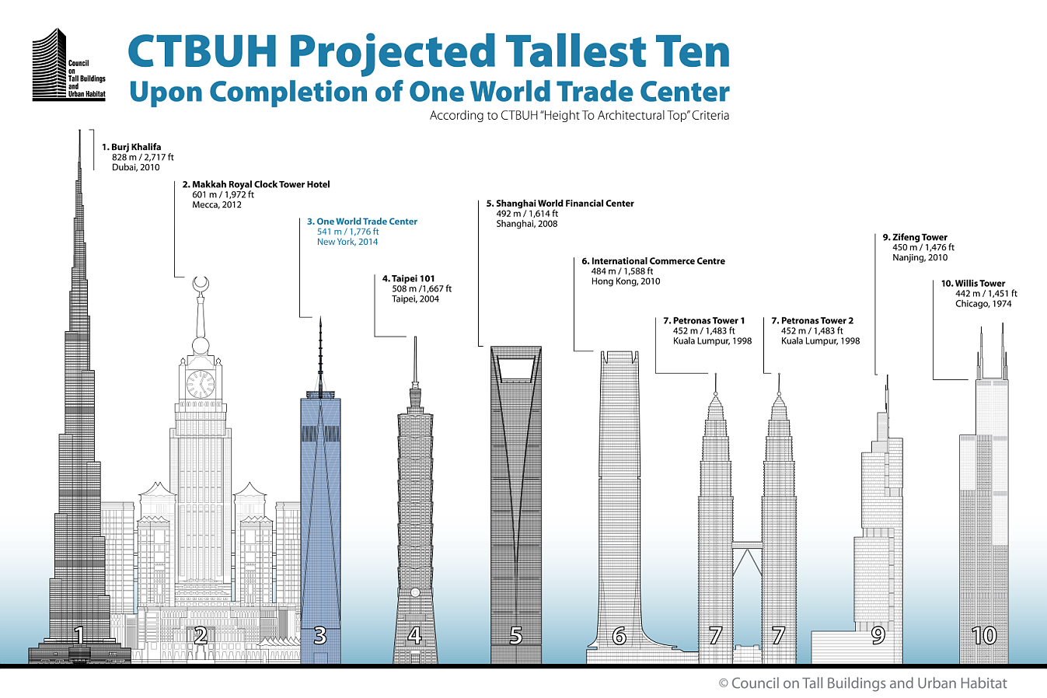

Slide 17
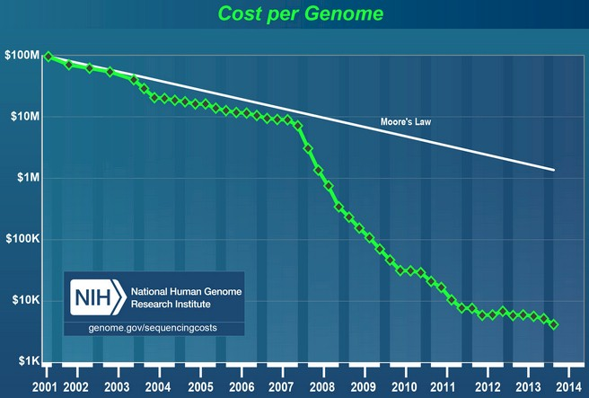

Slide 19

Heliocentrism Geocentrism

Slide 20
Predictive Biology
Predictive (adjective): to declare or indicate in advance; foretell on the basis of observation, experience or scientific reason.
Biology: a branch of knowledge that deals with living organisms and vital processes.

Slide 21
Best Linear Unbiased Prediction
Y = Xb + Zu + e

Slide 22
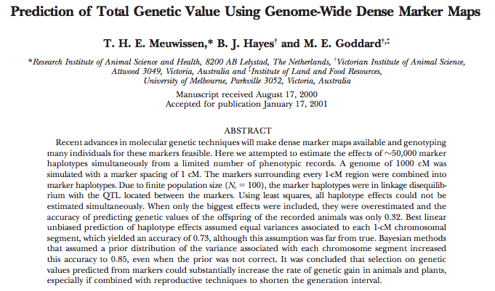

Slide 23
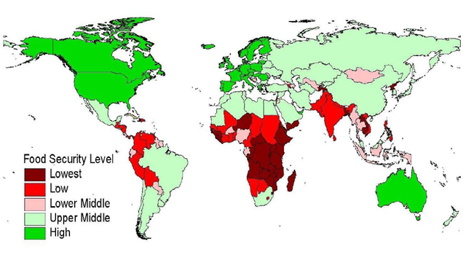
Global Food Security

Slide 24
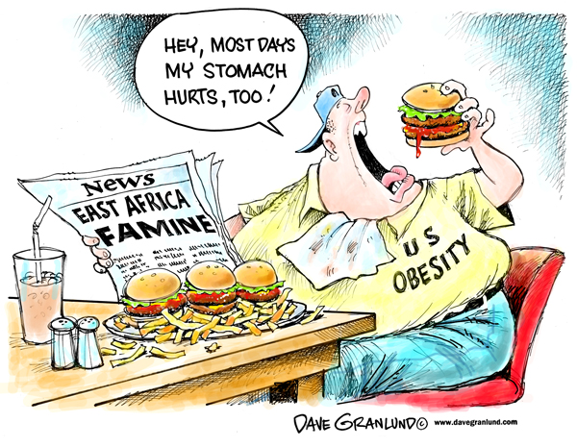

Slide 25
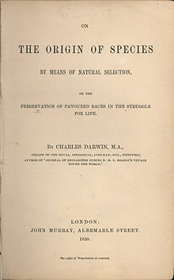
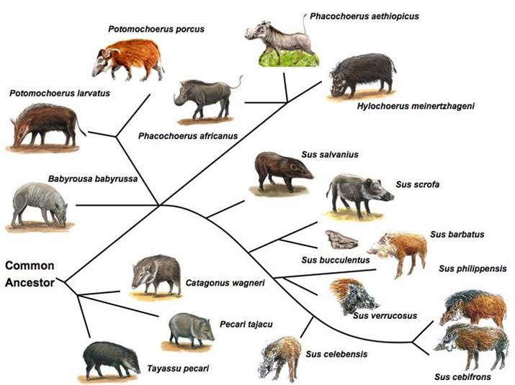
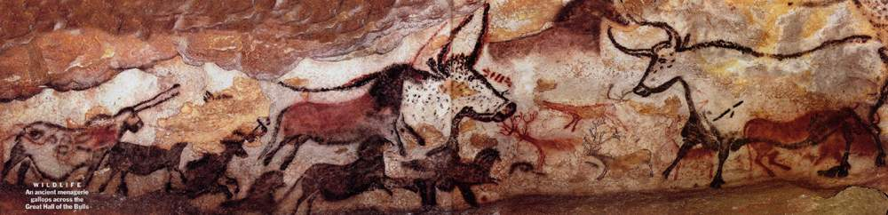

Slide 26
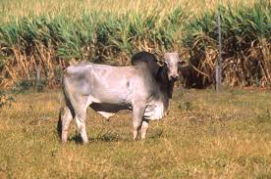
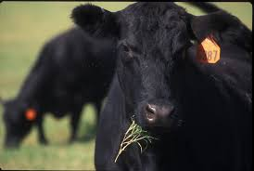
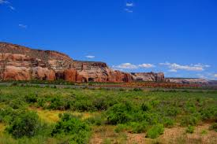
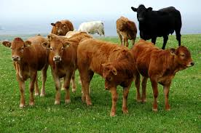

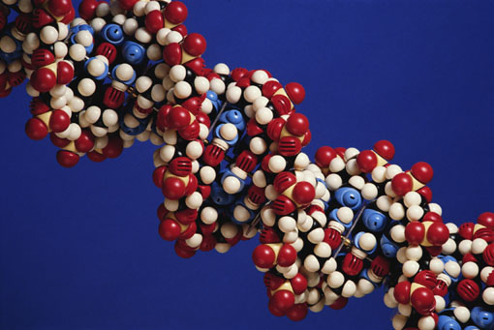

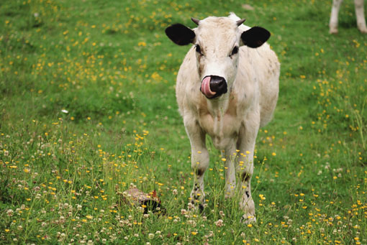
Genotype
Phenotype
Environment

Slide 27
Treatment
Age
Breed/Species

Slide 28

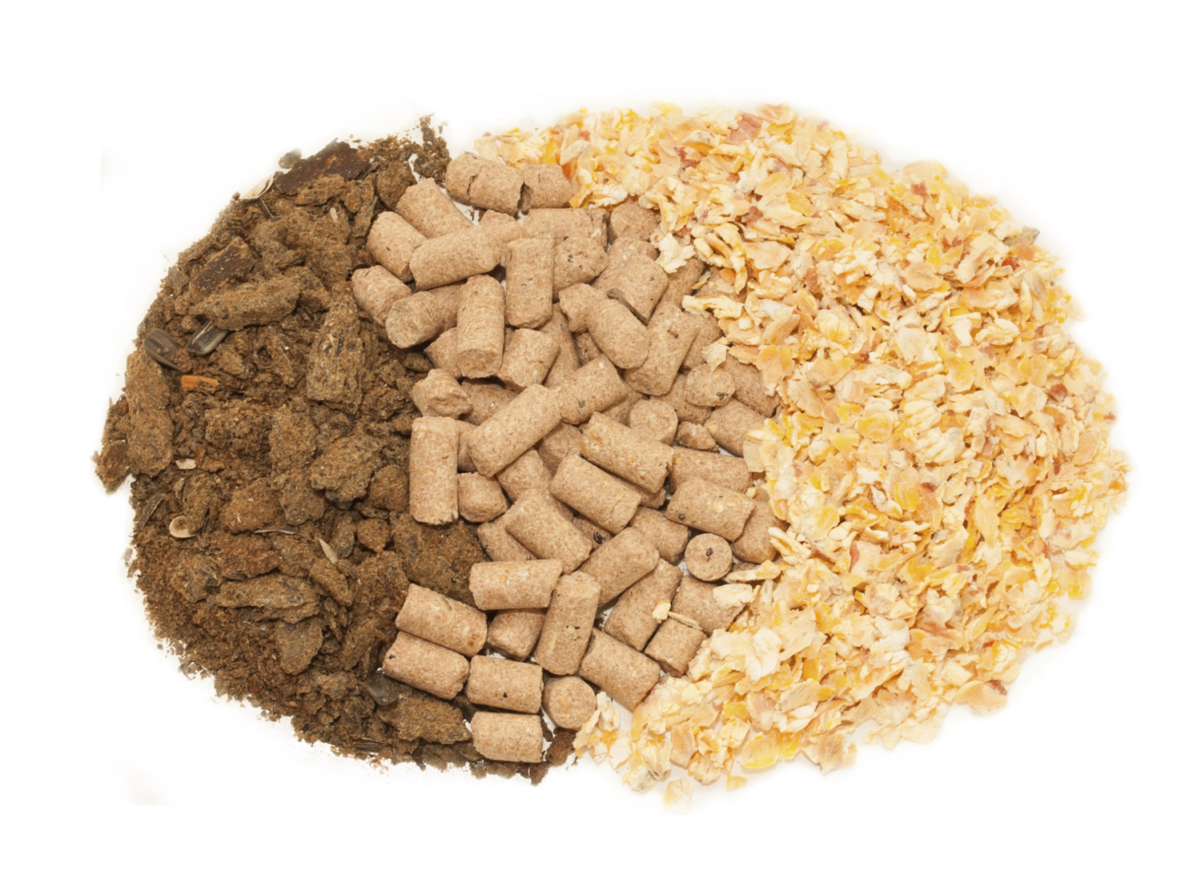
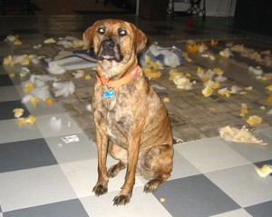

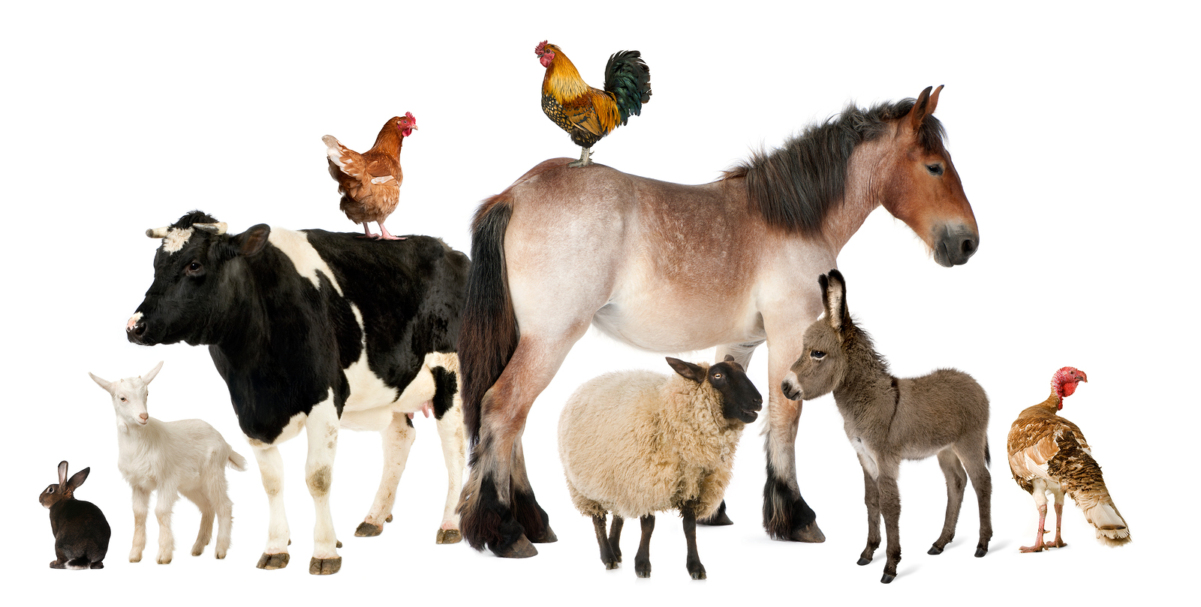

Slide 29
