Slide 1

Data infrastructure for analysis and discovery
Paul Flicek
Vertebrate Genomics, European Bioinformatics Institute
European Molecular Biology Laboratory
Wellcome Trust Sanger Institute

Slide 2
My charge
“Rather than a traditional one-to-many lecture, we looking for a session where you and the audience discuss what is needed to streamline implementation of data analyses within FAANG projects.”
I will consider “infrastructure” beyond hardware and software to include social infrastructure. I will be opinionated and expect these opinions to spark discussion and disagreement. Talking early and openly and an honest commitment to working for the common good is critical.

Slide 3
Concepts
Make things as good as possible, but don’t wait until they are perfect
  Understand and agree on the overall goal
  New things are always, always, always coming
Rapid, pre-publication data release occupies the scientific high ground
  Fight the temptation to restrict access, set embargos or set the project data apart from the community
Learn from the large-scale and collaborative projects around you
  Be special in the right way
Engage, buy in and accept that FAANG is a long term relationship
  Marriage is a useful analogy
Notes:
Note about mapping percentage.

Slide 4
Nature, 2012
Read Ewan’s commentary. Reread it regularly, but understand that it is not the only way.

Slide 5
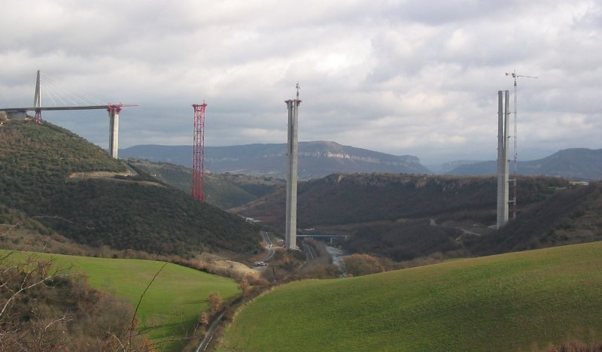
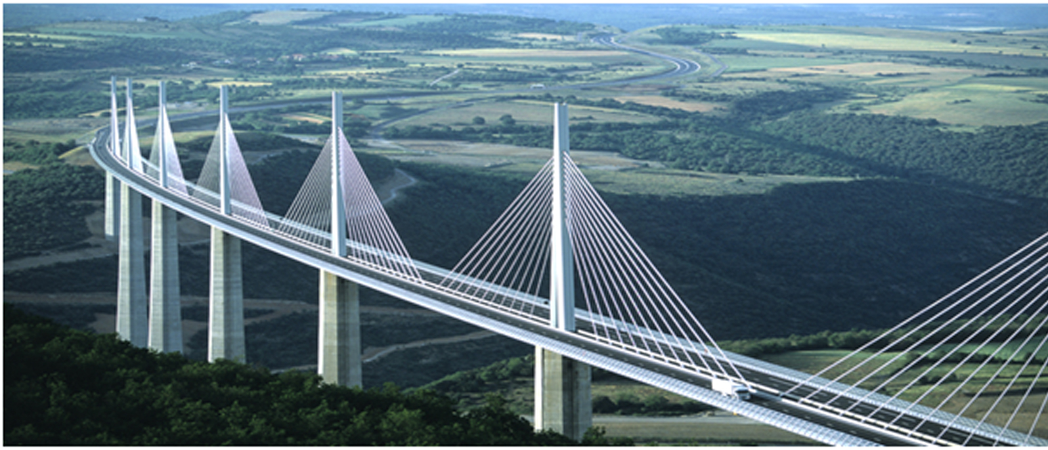


Informatics builds things and makes things work for genomics and big biology

Slide 6
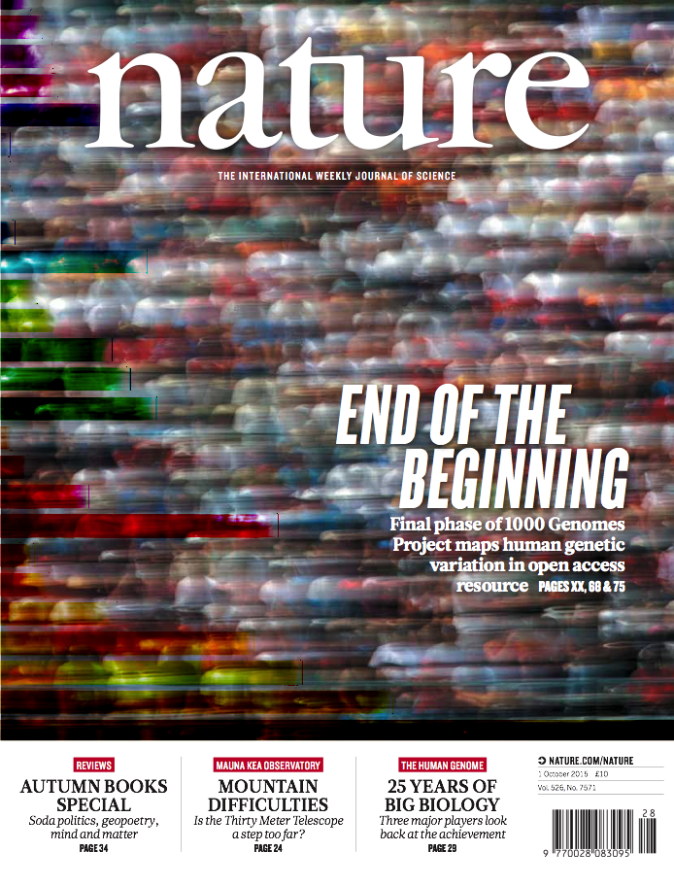
Data Coordination:
The 1000 Genomes Project and beyond
An orchestration role that enables highly efficient large-scale science
From raw data to project analysis to data release and community support
Methods adapted for epigenetics, agricultural and iPS projects
Clarke, et al (Nat Meth, 2013)

Slide 7
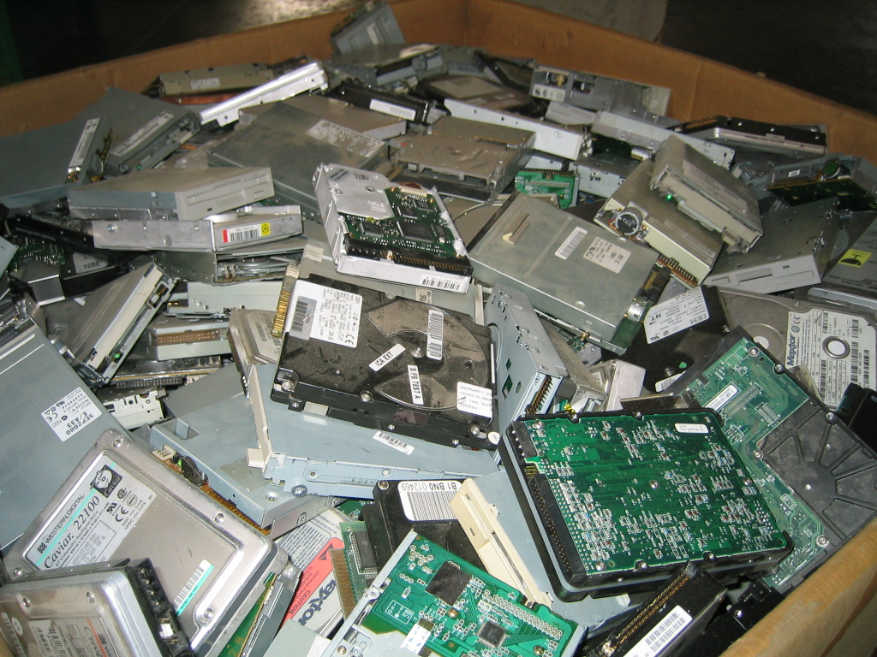
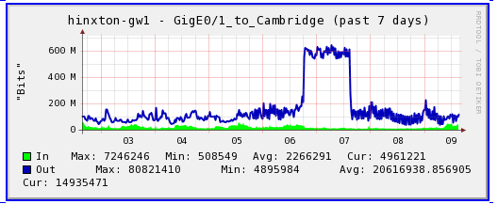
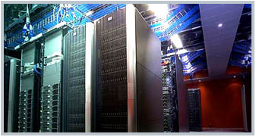
Managing the 1000 Genomes data
What it felt like in April 2008
First major data transfer
Today
Notes:
I have a deep love of large and complex problems. I like to solve them myself and watch when others are faced with them and can solve them.
The fastest cars is useless without roads

Slide 8
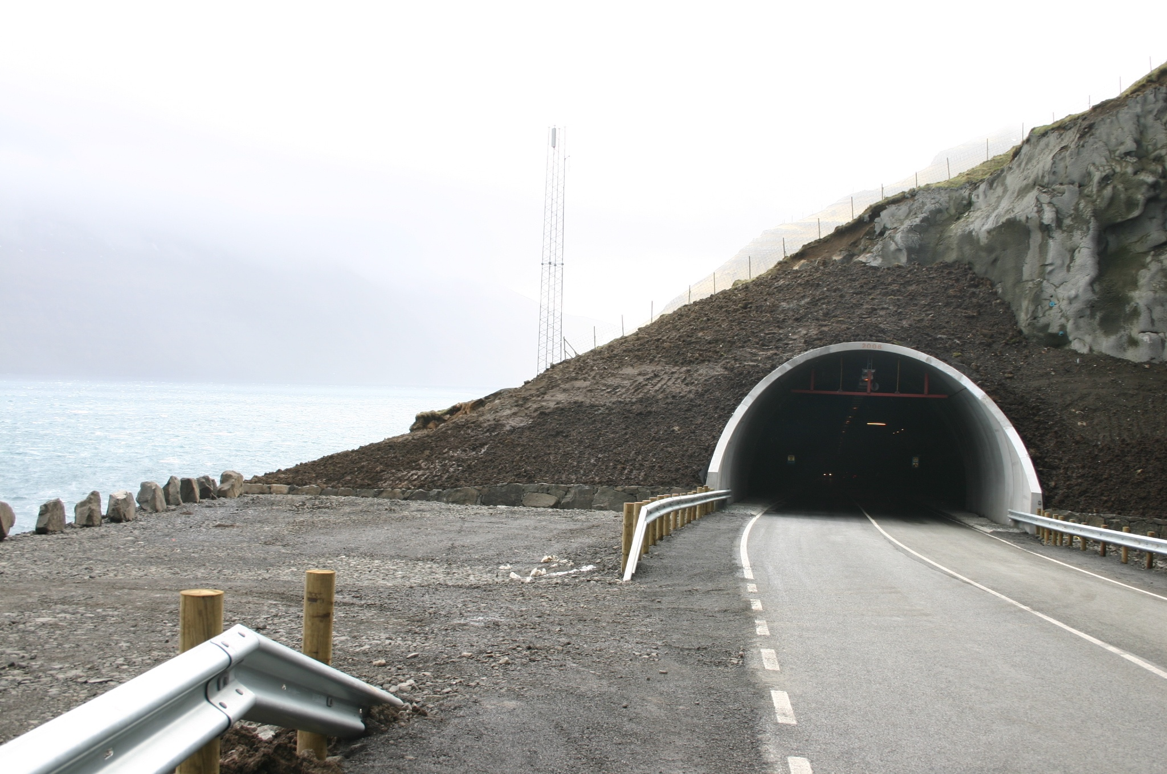
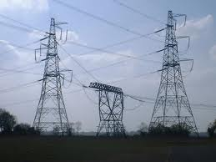
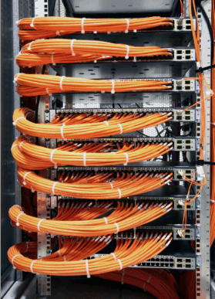
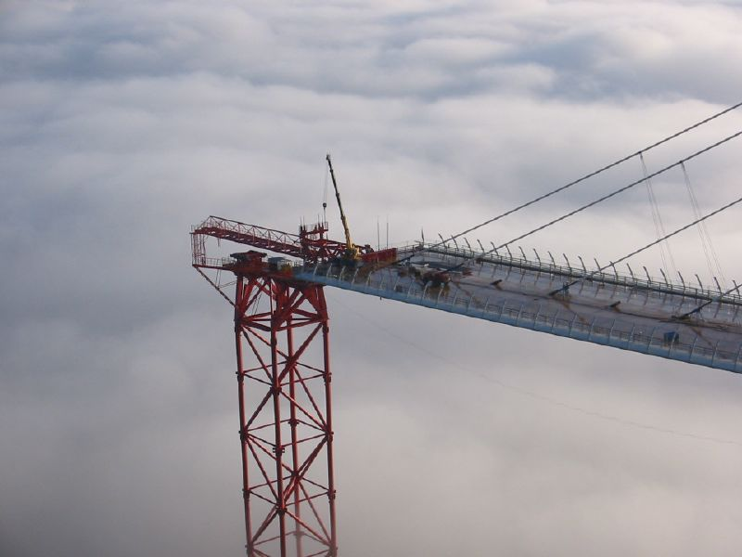
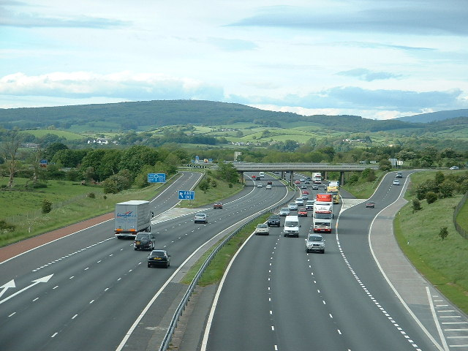
Infrastructures are critical…
Notes:
My degrees are in physics and engineering. Building infrastructures is fun. Pushing what we have created to test the limits is fun.

Slide 9
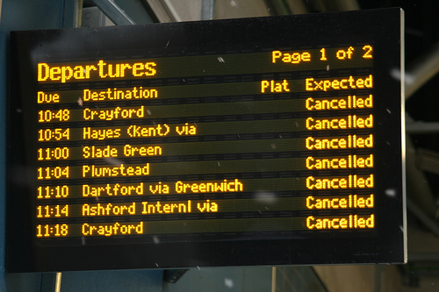
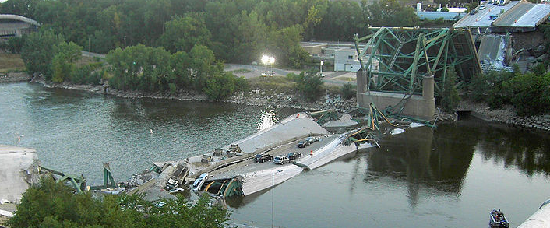
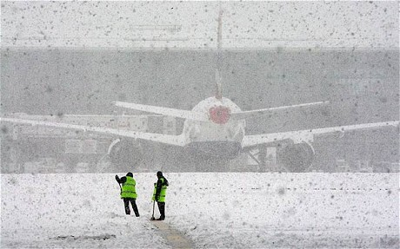
But we only notice them when they go wrong
Notes:
Even so, infrastructures are normally invisible.

Slide 10
Informatics is Infrastructure:
Data Archives and Standards
Data Coordination and Analysis
Expectations and Ambition

Slide 11
Data growth

Slide 12
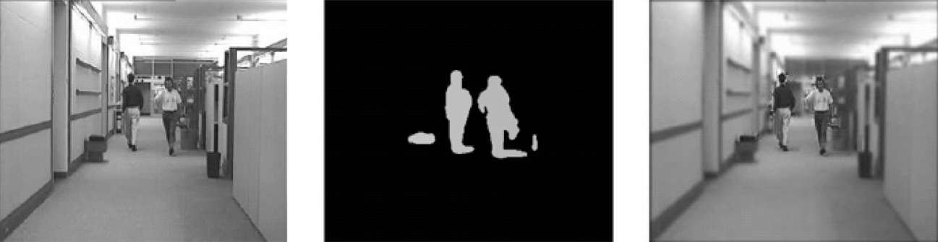
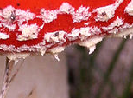
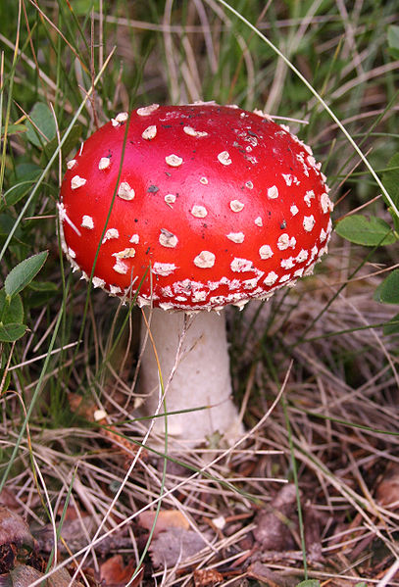
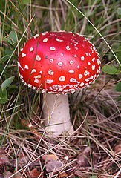
Data compression: horizontal and vertical
Jong-Seok Lee et al. (2009), http://mmspg.epfl.ch/files/content/sites/mmspl/files/shared/lee_icme.pdf
Photograph from MichaelMaggs, http://en.wikipedia.org/wiki/File:Amanita_muscaria_(fly_agaric).JPG

Slide 13
In how many ways can you say “female”?
18-day pregnant females | female (lactating) | individual female | worker caste (female)
2 yr old female | female (pregnant) | lgb*cc females | sex: female
400 yr. old female | female (outbred) | mare | female, other
adult female | female parent | female (worker) | female child
asexual female | female plant | monosex female | femal
castrate female | female with eggs | ovigerous female | 3 female
cf.female | female worker | oviparous sexual females | female (phenotype)
cystocarpic female | female, 6-8 weeks old | worker bee | female mice
dikaryon | female, virgin | female enriched | female, spayed
dioecious female | female, worker | pseudohermaprhoditic female | femlale
diploid female | female(gynoecious) | remale | metafemale
f | femele | semi-engorged female | sterile female
famale | female, pooled | sexual oviparous female | normal female
femail | femalen | sterile female worker | sf
female | females | strictly female | vitellogenic replete female
female - worker | females only | tetraploid female | worker
female (alate sexual) | gynoecious | thelytoky | hexaploid female
female (calf) | healthy female | female (gynoecious) | female (f-o)
hen | probably female (based on morphology)
female (note: this sample was originally provided as a \"male\" sample to us and therefore labeled this way in the brawand et al. paper and original geo submission; however, detailed data analyses carried out in the meantime clearly show that this sample stems from a female individual)",

Slide 15
Four stages of project data coordination
Stage 1: This can’t be so hard
  We’ll just get a couple of undergraduates and some hard drives from Amazon
  It cost’s how much?
  You can only do what?
  Danger is unrealistic expectations

Slide 16
Four stages of project data coordination
Stage 2: The source of all problems in the project
  These people are idiots and in the way
  Why aren’t they doing X, Y, Z and not A,B,C?
  How come you didn’t know that we had planned a press announcement for four months?
  Perceived acceptable standard is perfection and only acceptable time frame is yesterday
  This stage normally includes an “intervention”

Slide 17
Four stages of project data coordination
Stage 3: It works! Mostly.
  Lots of agreement on how things should be done
  Mostly just getting on with it
  The culmination of a tremendous amount of work
  Best science done here
  We will be supporting multiple constituencies
    Data generation groups
    Affiliated analysis groups
    Members of the community that want to use this data

Slide 18
Four stages of project data coordination
Stage 4: See, that wasn’t so hard
  Characterised by unrealistic new requirements
    “We just made an agreement to triple the size/complexity/usability of the data. Sorry we didn’t tell you before, but this is ok right?”
    “We going to extend the project by 2 years. There is no additional funding, but things are going pretty well for you, right?”
    “This other group has a great idea for analysis/data flow. Can you quickly integrate all of their work?”

Slide 19
Getting though the stages
Communication, communication, communication
  We don’t know all the details of what is going on either
  We all have conflicting requirements and multiple top priority tasks
    Help us though these as we all try to be understanding
Pick up the phone!
  The universal truth of email is that you know exactly what you meant
  Human cognitive evolution has not caught up to these environmental changes

Slide 20
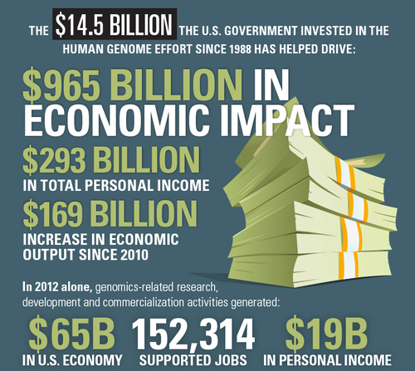
Our biases about open data
Genomics repeatedly shows that freely available data and resources drive innovation
  Centralised and well-maintained reference resources are critical
EBI is publicly and grant funded to committed to ensuring that our data will always remain in the public domain
United for Medical Research

Slide 21
Some things we often hear
“It should work just like Google or Apple”
“I want a button that does all of my analysis automatically”
“We have a critical deadline”
“The cloud will solve this problem”

Slide 22
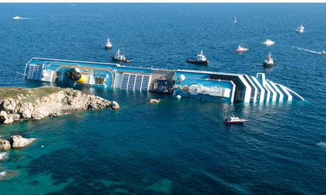
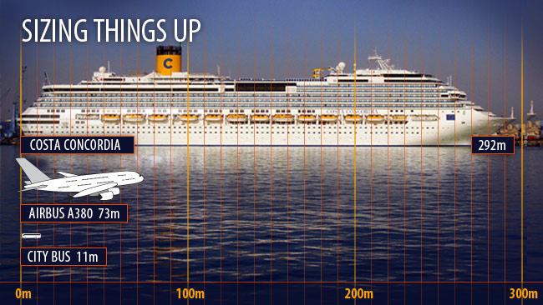
Big problems need solutions
Source: Guardian.co.uk
Graphic: Matt Pike Source: News Limited

Slide 23
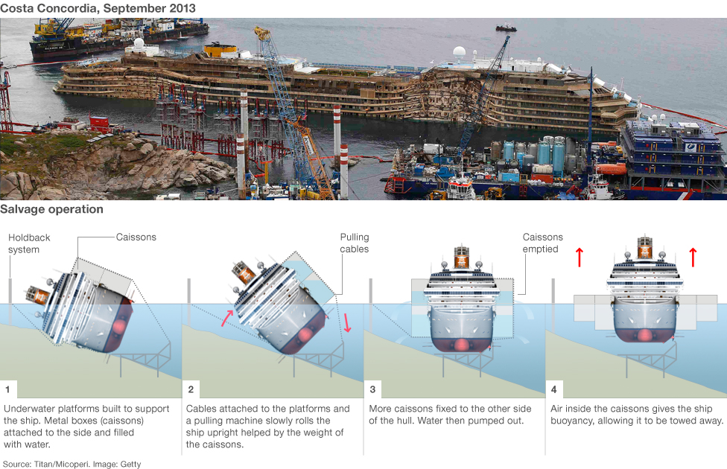

Solutions are often possible, but rarely free

Slide 24

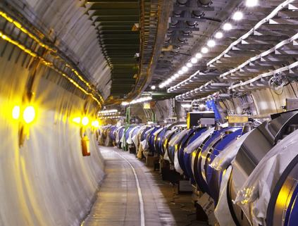

Infrastructure enables discovery
Interesting, ground breaking
ideas
Necessary (if conceptually
unexciting) data management

Slide 25
Conclusions
Informatics is about building high-quality, integrated tools and resources to enable genomic science, create stability and facilitate reproducibility
Understanding biology requires viewing problems from multiple vantage points. Connecting the views from big projects to small projects drives results and creates insights

Slide 26
Discussion Questions
How many people are concerned about the 2009 Toronto Agreement standards that FAANG has adopted?
  How will data release be managed?
  Note that Ewan Birney (one of the key authors of the Toronto statement) questioned Toronto’s “clumsy etiquette-based restrictions” in his 2012 commentary
What new analysis tools need to be developed?
What are the most important questions and how should the data infrastructure be set up to answer them?
Notes:
Funders have considerable influence in how raw and analysed data are released, and should design policies that maximize reuse. Early data-release policies focused on how data should be shared before publi- cation, with clumsy etiquette-based restric- tions on the first publications of global analysis, such as waiting for the authors who generated the data to publish their analyses before others can publish on the entire data set. These agreements are start- ing to show their age and a lack of clarity.
The new era of analysis calls for a rethink, with more focus on the release of intermediate analysis throughout the project, so that the community can use the resource more fully during the project; the 1000 Genomes consortium has done well in this regard.

Slide 27

From Sequence
to Knowledge

Slide 28
Standards, processes and methods for ethical data sharing
Extensive engagement across the group related to data infrastructure, security, variation annotation, BRCA
Major relevance to Ensembl and EBI’s data archives

Slide 29
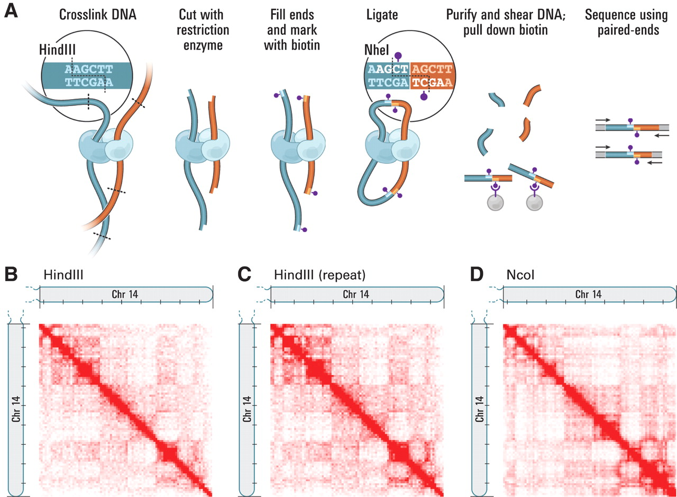
Connecting regulatory regions to genes: Promoter Capture Hi-C
Enhances Hi-C by pulling down promoter regions
  Resolution goes from Mbp regions to ~4kb restriction enzyme blocks
  Developed by Peter Fraser’s group at the Babraham
New methods were developed to process this new assay
  Signal processing: HiCcup
  Statistical significance test: CHiCAGO (Spivakov group, Babraham)
Ensembl has developed methods to store and display this data
Erez-Lieberman et al., Science, 2009.

Slide 30
Comparative regulatory genomics
Mapping the same DNA-protein interactions in the same tissue in different species
Transcription factors, histone modifications, chromatin structural proteins
ChIP-seq data supported by RNA-seq and other assays
Identify regions of the genome doing the same thing over evolutionary time: functional conservation
Villar, et al (Cell, 2015)

Slide 31
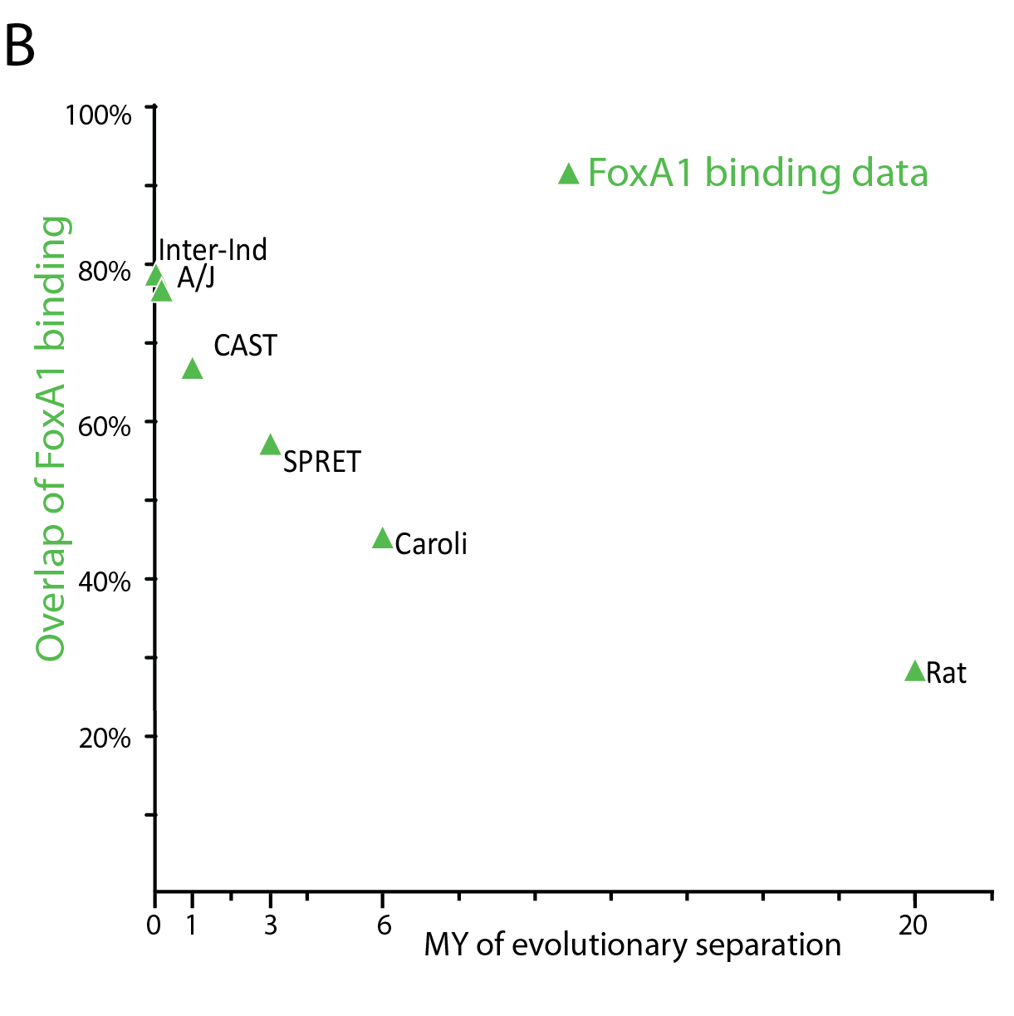
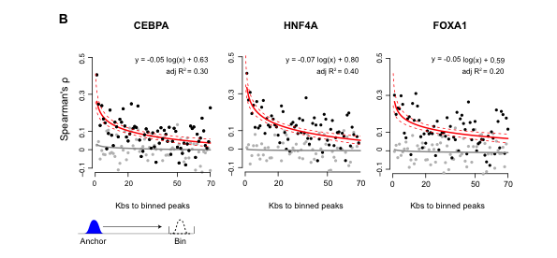
Regulatory rewiring is pervasive in mammalian genomes
Transcription factor binding evolves extremely rapidly
F1 analysis shows that transcription factor binding is influenced by surprising large regions of the genome
Sequence changes in binding motifs cannot explain the changes in transcription factor binding
Wong, et al (Unpublished)
Notes:
Figure 2 . Evolutionary changes in transcription factor binding cannot be explained purely by genetic changes in directly bound sequence motifs.
(A) Decay of transcription factor binding and the underlying sequences. For five rodents and human, we compared how rapidly the transcription factor binding regions overlap with C57BL/6J (primary Y-axis, black) plotted against the estimated evolutionary distance to the nearest common ancestor (X-axis). The datapoints are colored by the specific TF evaluated (red=CEBPa, Blue=HNF4a, Green=FOXA1). On the secondary Y-axis (grey), we simultaneously plot how frequently the core 15 to 51 bp bases directly beneath the binding region summit for each transcription factor are perfectly matched in sequence between C57BL/6J and each second species. The probability of larger sequences being identical between species is always lower; therefore, comparison of steadily increasing sizes of sequences creates a contour effect.
(B) Most observed CEBPa binding changes do not contain alterations in the bases of directly bound motifs (Methods). We categorized binding events by whether they were unshared (top bar chart) or shared (bottom bar chart) between C57BL/6J and a second species. We then identified whether the directly bound motif is identical (grey bar) or contains genetic variation (white bar). Variation increased with evolutionary distance; unshared binding events had modestly greater changes in their bound genetic sequences (p < 2.2 E⁻¹⁶ with Fisher exact test). The vast majority of peaks do not have genetic sequence changes within their directly bound motifs; importantly, this is true for unshared peaks where for instance less than a quarter of C57BL/6J peaks not found in Spretus have variation from the C57BL/6J reference.
KS change legend

Slide 32
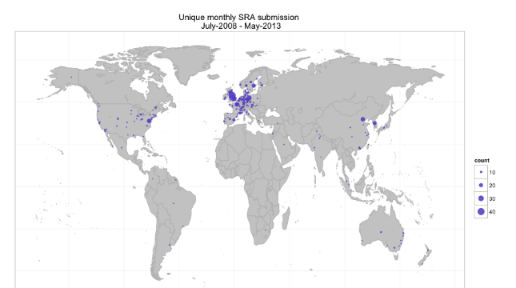
Distributed production: sequence data submission

Slide 33
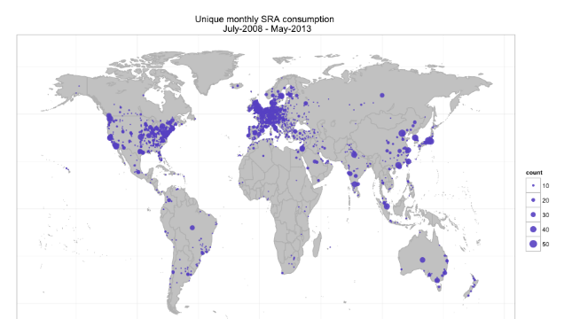
Distributed consumption: sequence data access

