Slide 1
FAANG: Status on Data creation
Gathering On Functional Annotation of ANimal Genomes (GO-FAANG Workshop)
Washington DC, October 7-8
Elisabetta Giuffra
INRA- French National Institute for Agricultural Research
Jouy-en-Josas, France
Notes:
ASA paper: only if Michele replies

Slide 2
Contents of this talk
Context: the FAANG white paper
Animals/Samples/Assays Committee: current progress
FAANG samples/data collections so far*
Two pilot FAANG projects
* Items for discussion this pm (Breakout 1 session)
Notes:
To comment on your plans- I think if you could emphasize the organization of the collaborative work and development of common protocols ³already² so early in this process it would be important. Perhaps only hint that there are important additional organization to discuss, setting up the afternoon discussions.

Slide 3
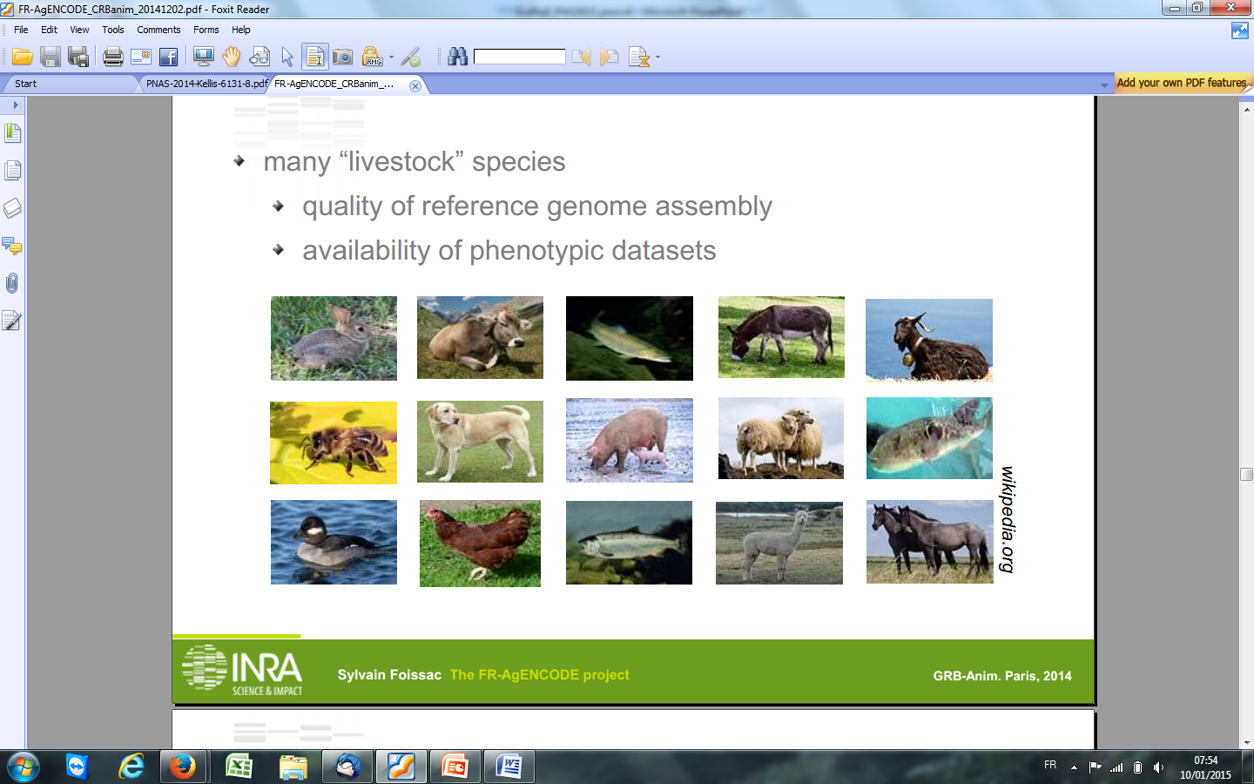
The FAANG white paper Andersson et al. 2015; PMID: 25854118
The unique value of domesticated animal species: wealth of genetic and phenotypic diversity shaped by natural + artificial selection
The FAANG project:
Obtain a biological reference for main species (i.e. with sufficiently annotated genomes)
Start genotype-to-phenotype studies:
Different developmental stages and physiological/environmental conditions, …;
Different breeds/ populations (involving industry);
  + Additional species…(new annotated genomes)
Notes:
To be shown at the end!!!!

Slide 4
Biological targets and assays for ‘data creation’
Andersson et al. 2015; PMID: 25854118
Members committed* to collecting, storing and sharing samples for first data
Single developmental stage (‘adult’)
Minimize genetic diversity within species
Focus on tissues/primary cells
Use well-established assays (white paper- Box 1)
*see FAANG Consortium policies
Notes:
The FAANG Consortium signatories (~300 as of May 2015) are
committing to i) work within the FAANG community to define and improve experimental,
metadata and bioinformatics standards, ii) ensure that experiments conducted to
produce functional annotation adhere to these standards, and iii) release all the
experimental and meta data in an open access manner, rapidly

Slide 5
The Animals/Samples/Assays (ASA) Committee
ASA
Aims:
Propose, develop and standardize animal/tissue collection protocols, storage practices, and assay protocols for the FAANG community (‘pilot projects’).
Foster collaborations, avoid redundancies and enhance synergies
faang-samples@animalgenome.org (presently: 52 members)
FAANG Poster # 4
Notes:
Only welel annotated genomes
To comment on your plans- I think if you could emphasize the organization of the collaborative work and development of common protocols ³already² so early in this process it would be important. Perhaps only hint that there are important additional organization to discuss, setting up the afternoon discussions.

Slide 6
Current progress
ASA
Samples from 6 species collected/being collected:
Adapting and optimising protocols of assays for tissues
Online:
RNA extractions (snap-frozen and RNAlater-preserved tissues) suited for RNA-seq and small RNA- seq
In pipeline:
- Blood cell sorting/per species and long term storage (for all assays)
- ChIP-seq on frozen tissues
- Hi-C on dissociated liver cells - Etc.

Slide 7
Examples of collection: chicken and cattle
ASA
Line/Breed | Dev. stage | Tissues/Cells | Country | # Tissues/Assays
Chicken
F1 (line 6X7) ADOL | 20 weeks (2 M) | all tissues | USA | 8/ RNA-seq, 4 histone marks, DNA-seq, CTCF (ATAC-seq)
F1 (line 6X7) ADOL | 2 and 8 weeks (M) | CD4 T lymphocytes/spleen | USA | 1/ RNA-seq
White Leghorn | 42 weeks (2M and 2F) | all tissues + CD4/CD8 T lymphocytes/spleen+ PBMCs | France | 3/ RNA-seq, small RNA-seq, Hi-C (ATAC-seq)
F1 (broiler x layer) | 20 weeks | all tissues | UK
Cattle
Line 1 Hereford | 14 months (2M) | all tissues | USA | 8/ RNA-seq, 4 histone marks, DNA-seq, CTCF (ATAC-seq)
Holstein | 2nd lactation (2F) and 85 weeks (2M) | all tissues + sorted PBMCs | France | 3/ RNA-seq, small RNA-seq, Hi-C (ATAC-seq)
Holstein (female) | 5th and 7th lactation, pregnant | all tissues | Australia | 78/ RNA-seq, 4 histone marks (submitted)
Holstein | adult | tissues from several organs | Canada
Holstein | Before and after weaning | tissues from rumen, intestin and liver | USA
Crossbred Cattle |  | all tissues | Canada | 10/ RNA-seq, small RNA-seq
Genetic diversity
Wide range of ‘adult’ stage
Physiological states differ
+ Technical heterogeneity in sampling
Notes:
Technical heterogeneity is largely unavoidable exp for several collections

Slide 8
Organize collections in BioSamples www.ebi.ac.uk/biosamples
ASA
FAANG samples catalogued and automatically connected to all metadata
assess common features across species,
assess heterogeneity among different portions/aliquots of same organ.
Collaboration with ‘Metadata & Data Sharing’ Committee in progress (defining minimum requirements, suitable ontologies, choice of reference databases and example metadata)
The heterogeneity of current collections represents a challenge but also an opportunity to anticipate the next FAANG phase
Notes:
Heterogeneity (technical, biological) should be managed and interpreted by meta-analysis of associated datasets
Genetic + Biological diversity both are needed to answer genotype-to-phenotype questions, i.e.: how functionality is altered by sequence variation?)

Slide 9
Examples of collection: chicken and cattle
ASA
Line/Breed | Dev. stage | Tissues/Cells | Country | # Tissues/Assays
Chicken
F1 (line 6X7) ADOL | 20 weeks (2 M) | all tissues | USA | 8/ RNA-seq, 4 histone marks, DNA-seq, CTCF (ATAC-seq)
F1 (line 6X7) ADOL | 2 and 8 weeks (M) | CD4 T lymphocytes/spleen | USA | 1/ RNA-seq
White Leghorn | 42 weeks (2M and 2F) | all tissues + CD4/CD8 T lymphocytes/spleen+ PBMCs | France | 3/ RNA-seq, small RNA-seq, Hi-C (ATAC-seq)
F1 (broiler x layer) | 20 weeks | all tissues | UK
Cattle
Line 1 Hereford | 14 months (2M) | all tissues | USA | 8/ RNA-seq, 4 histone marks, DNA-seq, CTCF (ATAC-seq)
Holstein | 2nd lactation (2F) and 85 weeks (2M) | all tissues + sorted PBMCs | France | 3/ RNA-seq, small RNA-seq, Hi-C (ATAC-seq)
Holstein (female) | 5th and 7th lactation, pregnant | all tissues | Australia | 78/ RNA-seq, 4 histone marks (submitted)
Holstein | adult | tissues from several organs | Canada
Holstein | Before and after weaning | tissues from rumen, intestin and liver | USA
Crossbred Cattle |  | all tissues | Canada | 10/ RNA-seq, small RNA-seq
Individual projects = « variable » research goals
2 ‘Pilot projects’ on multiple species
Notes:
Individual pilot projects have limited capacity and necessarily reflect different scientific goals (eg samples are from target breeds/populations with phenotyping records/ connected to parallel studies)
Challenges faced (INRA): Samples and Assays go ‘together’ (formidable task, complexities to list later)
The two examples fo UC-Davis and INRA

Slide 10
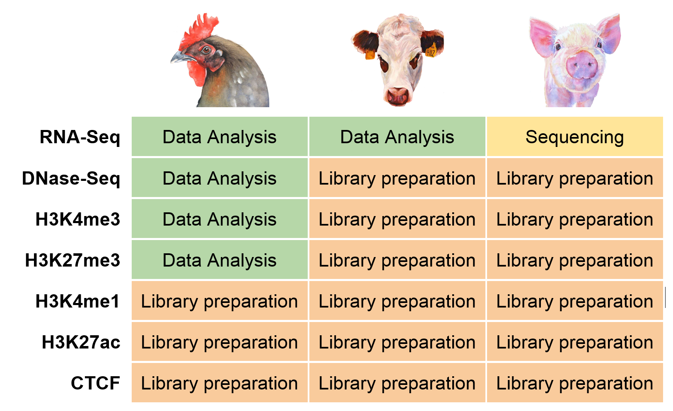




Project 1: Genome-wide identification and annotation of functional regulatory regions in livestock species
Poultry, Cattle, and Pig Genome Coordination Funds
GO-FAANG workshop, Washington, DC – Oct. 7-8, 2015

Slide 11
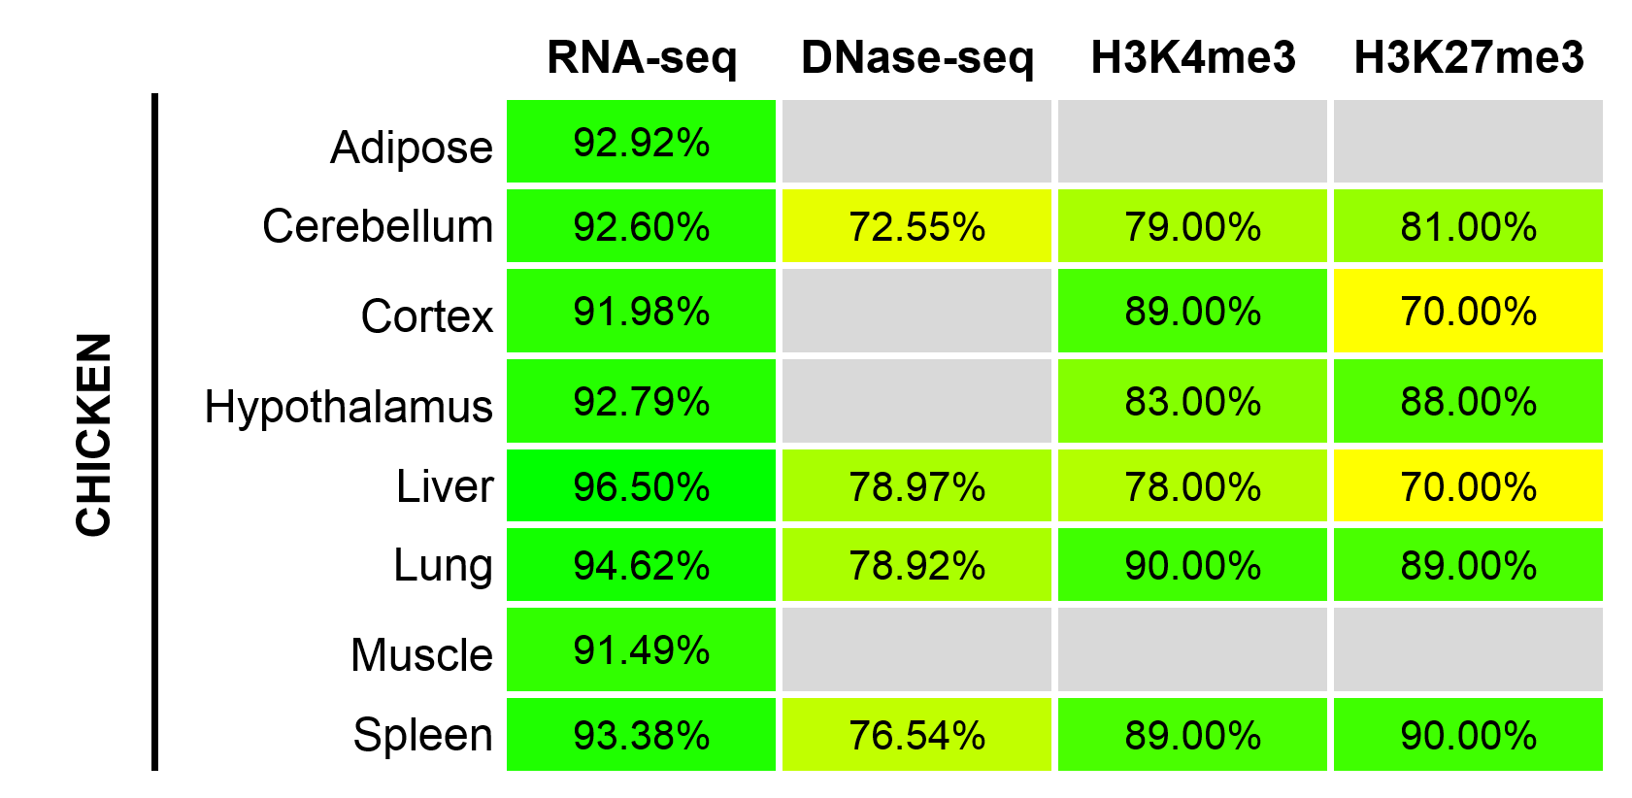
See Poster #12
Data Quality
Percent of reads aligned to Galgal4:
Poultry, Cattle, and Pig Genome Coordination Funds
GO-FAANG workshop, Washington, DC – Oct. 7-8, 2015

Slide 12
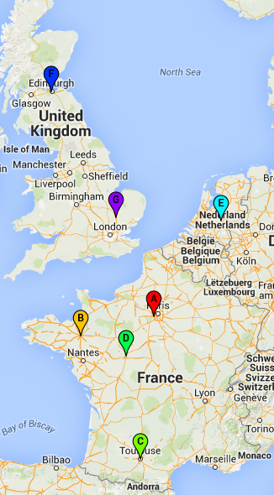



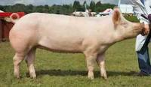

Project 2: Fr-AgENCODE (INRA SelGen Metaprogramme)
‘All’ tissues FAANG sample collection from 4 species
Few target tissues for assays (chosen to benefit parallel ongoing research):
Liver (hub tissue) and two primary lymphoid cells (CD4+, CD8+)
Invest in the optimization of ‘new’ methods
Assays:
- RNA-seq , small RNA-seq, Hi-C, ATAC-seq
Experimental animal facilities
National infrastructure of Biological Resource Centers for domestic animals - (http://www.crb-anim.fr/)
Notes:
Ref to: Current and future science fronts (report GA)
Hi-C: High resolution Hi-C maps allow the identification of chromatin sub-domains, loops between promoter-enhancer, and specific interactions linked with gene expression (Rao et al. 2014), thus providing in a single assays a virtually complete set of functional annotations.
16 different maps of DNA-DNA interactions
A minimal resolution of 100kb for each map (with at least 1000 contacts for each 1Mb bin)
For a 3Gb mammalian genome, to reach a 50-100kb resolution: 70M of paired-reads/library

Slide 13
see Posters #4,5
Achieved:
Biorepository of 4 species (INRA, @Bridge platform)
- 4 biological replicates (2M, 2F)
- Snap-frozen +
Preserved blood cells (CD4+, CD8+, PBMCs for further sorting) and crosslinked nuclei from some dissociated tissues
Expected end 2015:
Hi-C and ATAC-seq assay optimization completed
  2016: All sequencing runs (liver, blood cells) + Start of bioinformatic analyses
  See Poster #17 (ex. of parallel research: lncRNAs in chicken)
Notes:
Recently, the Mouse ENCODE Consortium reported that comparative gene expression data from human and mouse tend to cluster more by species rather than by tissue. This observation was surprising, as it contradicted much of the comparative gene regulatory data collected previously, as well as the common notion that major developmental pathways are highly conserved across a wide range of species, in particular across mammals. Here we show that the Mouse ENCODE gene expression data were collected using a flawed study design, which confounded sequencing batch (namely, the assignment of samples to sequencing flowcells and lanes) with species. When we account for the batch effect, the corrected comparative gene expression data from human and mouse tend to cluster by tissue, not by species.
http://f1000research.com/articles/4-121/v1
Let me quote a nice piece of the abstract: "Here we show that the Mouse ENCODE gene expression data were collected using a flawed study design, which confounded sequencing batch (namely, the assignment of samples to sequencing flowcells and lanes) with species." => exactly what we were planning to do.
On top of that, one of the reviewers who accepted that paper is Mick Watson, who is leading the FAANG data analysis sub-committee. He would not miss that. Mixing libraries from different samples in the same sequencing runs is the best way to spare us this embarrassing criticism. Of course this can be done for each assay separately.
Anyway, please note that this would not impact our data analysis design: we can still present a first batch of results on one tissue x 2 species x 2 assays then a more extended study, or consider any other publication scheme depending on the results.
Ref to: Current and future science fronts (report GA)
Hi-C: High resolution Hi-C maps allow the identification of chromatin sub-domains, loops between promoter-enhancer, and specific interactions linked with gene expression (Rao et al. 2014), thus providing in a single assays a virtually complete set of functional annotations.

Slide 14
Join us!
Breakout 1: Data creation
Time: 2:30 – 4:00 Room: NAS 120
Discussion Leaders: Elisabetta Giuffra and Huaijun Zhou
Recorders: Hans Cheng, Joan Lunney
We will discuss current challenges in standardizing sample collection and assays due to the specific complexities of domesticated animals, and explore options on how to implement the next phase of FAANG.
Genetic diversity
Wide range of ‘adult’ stage
Physiological states differ
+ Technical heterogeneity in sampling
National funding = « variable » research goals
moving forward to next FAANG phase
Notes:
From NSF purposes for GO-FAANG
The main purpose of the GO-FAANG Workshop is to advance the goals of the
FAANG initiative. This will be accomplished through discussions and decision-making to
fulfill three objectives; 1) establishing priorities for functional genomics research efforts
within and across species; 2) planning the management structures required for efficient
use and sharing of samples, data and computational tools; and 3) identifying resources
needed to accomplish these goals.
For goal (2) on planning management structures, we have several of these in place
for initial organization (see www.FAANG.org for the raison d’être for these committees),
but further refinement to develop sustainable leadership and communication structure,
as well as create effective methods to manage the expanding needs of our diverse
consortium, all while enabling these broad and diverse datasets to be used in answering
fundamental biological questions, is important.

