Slide 1
GO-FAANG Workshop
7-8 October 2015
Stephen.Elsby@RCUK.AC.UK

Slide 2
The Genome-Phenome Gap
Genotype
Genetic endowment
Development
In given environment
Phenotype
Observable traits
How do environmental cues influence genotype to impact on phenotype?
How can genotypes be tailored to deliver desired phenotypes?
Can desirable traits be mapped back to genotype to further understanding and enable exploitation?

Slide 3
Data intensive bioscience
timeline of some key BBSRC activities
Bioinformatics and Biological Resources Fund established
(£45.4M - 2013)
National Plant Phenomics Centre opens
Community networks in metagenomics and data visualisation
Tools and Resources Development Fund established (£12.4M software- 2013)
ELIXIR technical hub opens (£75M)
BBR Fund: Big Data awards 1
Proteomics and e-Science training (£330K)
Systems Approaches to Biological Research (SABR, £30.5M)
SysMO 1
(£8.1M)
eLearning for systems approaches SysMIC (£1.1M)
North Wyke Farm Platform launched
2003
2004
2005
2006
2007
2008
2009
2010
2011
2012
2013
2014
Bioinformatics and e-science programme II (£12.5M)
ANR-BBSRC SysBio (£4.8M)
UK ELIXIR node (£1.3M)
TGAC officially opened
BBSRC crowd sourcing call
SysMO 2
(£5.6M)
UK Plant Phenotyping Network
E-science Development Fund (£1.1M)
Centres for Integrative Systems Biology phases I and II (£46.3M)
BBSRC partners in HECToR
E-infrastructure at TGAC and Rothamsted
BBSRC co-fund NSF Arabidopsis Information Portal

Slide 4
Next Steps
Clear challenges
International scale
Co-ordinated community
Basic research challenge clear - is impact as well articulated?
What can be done with existing mechanisms – what needs greater funder co-ordination?

Slide 5
Other Slides

Slide 6
What are the Challenges?
Data standardisation and interoperability
Data storage
  Where
  Who pays
Stability and longevity
Speed of analysis
Rewards and incentives
Skills and training
Regulatory environment
New technologies
  Implications for all of the above

Slide 7
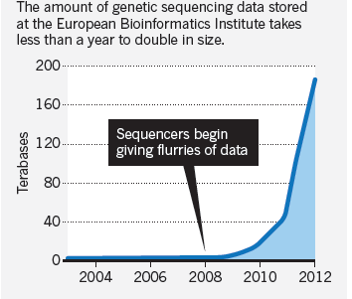
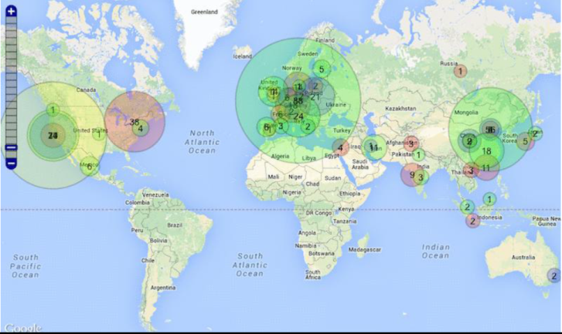
Data Explosion in
Bioscience
Each day in 2012, EMBL-EBI received about 9 million online requests to query its data, a 60% increase over 2011
Image: EMBL: EBI

Slide 8

What has driven increase
in data in biosciences?
Need to improve human health and disease understanding
Technological revolution in sequencing
  Applicable across entire life sciences
Increased automation of readouts at all levels (genome, proteome, metabolome………)

Slide 9
GxE=P: Key Concepts
The relationship between genotype, phenotype and environment underpins much of biology
The ability to study genotype-phenotype-environment interactions is given new impetus by rapid technological developments in:
  Genomics
  Other ‘omics-based technologies
  Imaging
  Phenotyping, especially systematic phenotyping
  Computational biology

Slide 10
GxE=P: Opportunities
Ability to tackle questions not possible before
Integrated view of cellular and organismal biology (via a modelling framework)
Better understanding of networks underlying phenotypes of interest, how the environment affects them and how they might be (re)engineered
A more holistic understanding of evolution (e.g. selection acting on the whole organism or sets of traits and how that affects the genome)

Slide 11
GxE=P : Potential benefits
Development of crops and livestock with improved traits e.g., increased resistance to disease in crops and animals
Micro-organisms capable of producing defined molecules, e.g. biofuels, fine chemicals, bioactive molecules, new antibiotics
Improvement of health throughout life, arising from a better understanding of the influence of diet and nutrition on health and ageing

Slide 12
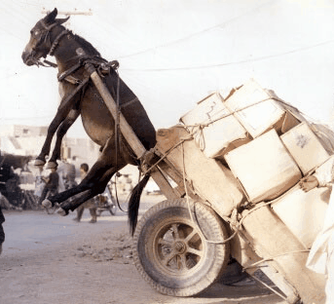
Rapid Progress Is Needed
“If I could, I would routinely look at all sequenced cancer genomes. With the current infrastructure, that's impossible”
(Ewan Birney, EBI)
)
Bioinformatics
Data
Notes:
http://www.nature.com/nature/journal/v498/n7453/full/498255a.html

Slide 13
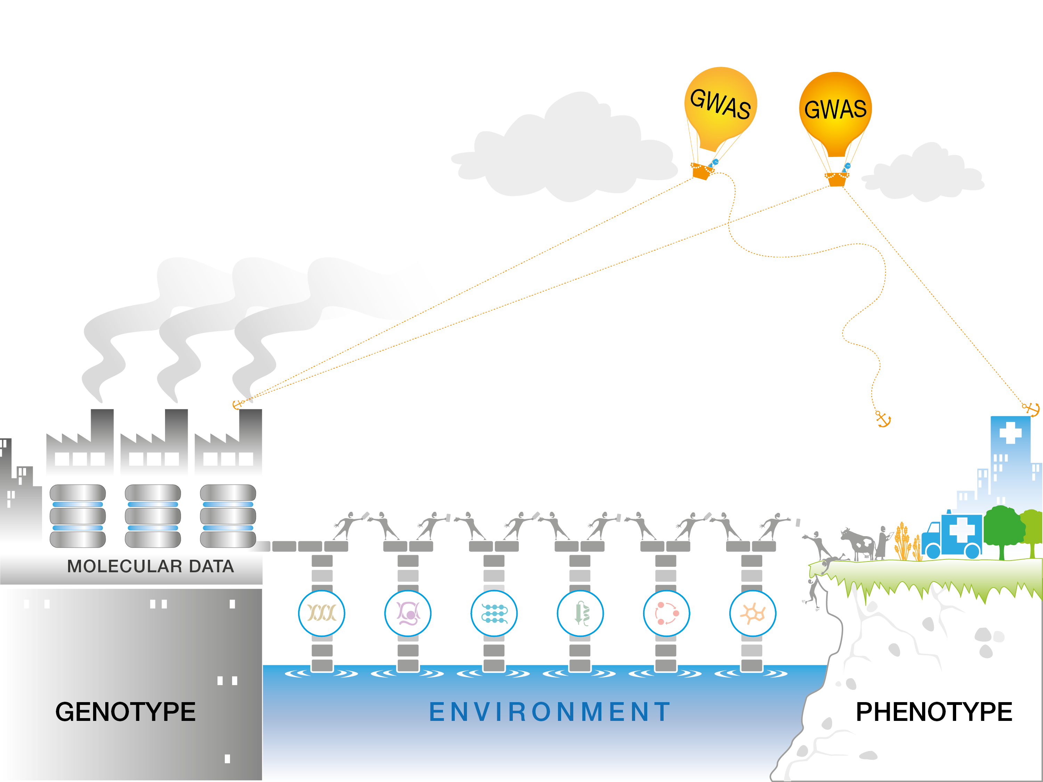
Genotype to phenotype
Notes:
Provided by EBI

Slide 14
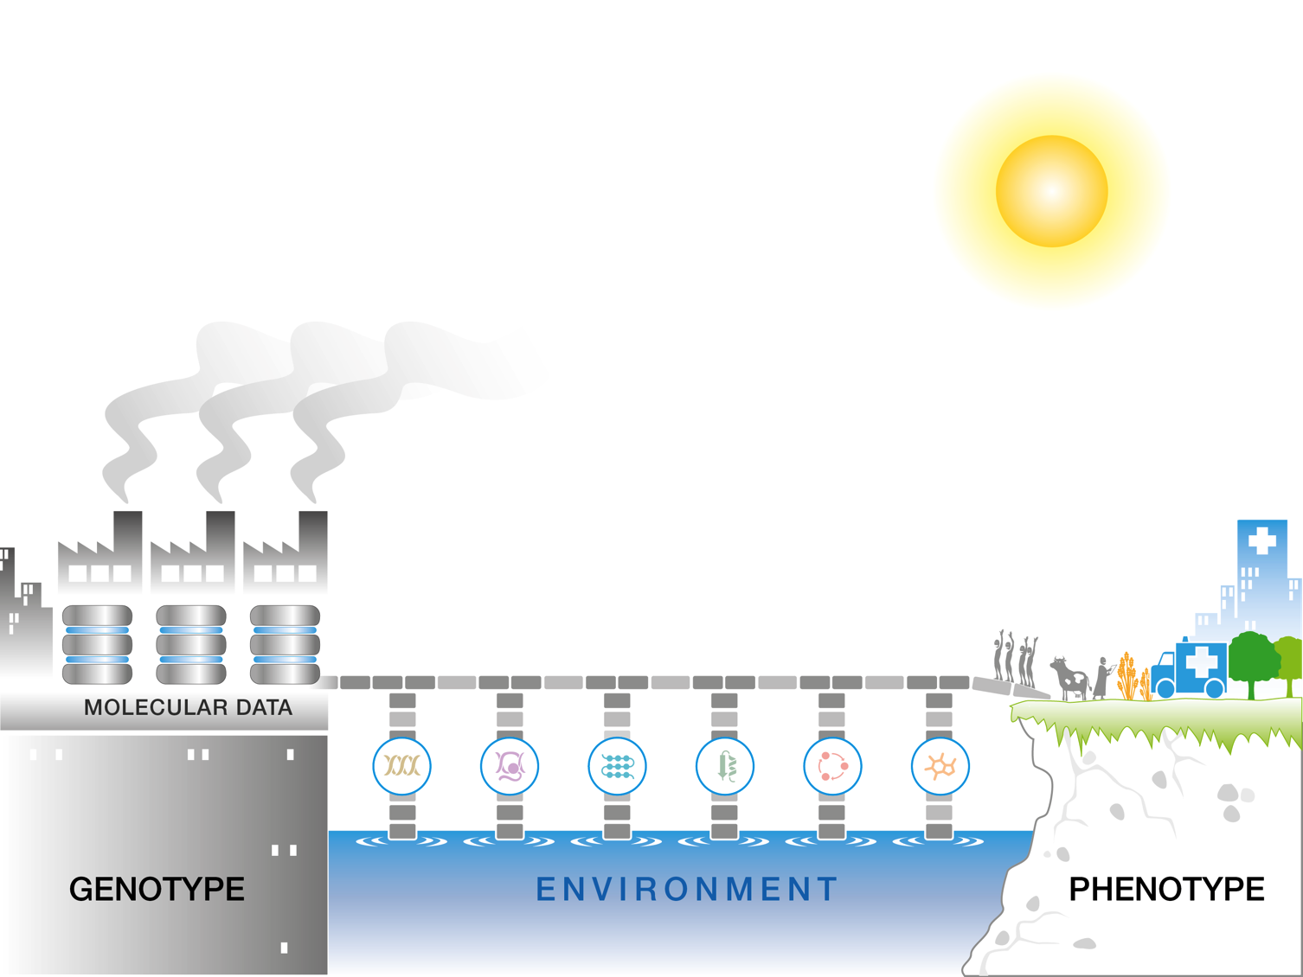
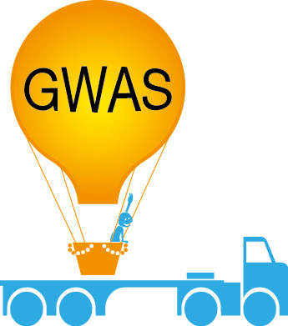
Genotype to phenotype
Looking to the future
From basic biology and data to translation
Notes:
Provided by EBI

