Slide 1
GO-FAANG:
Gathering On Functional Annotation of Animal Genomes
Workshop
October 7-8, 2015
National Academy of Sciences Building
Washington, DC

Slide 2
Thanks for GO-FAANG financial support!

Slide 3
Thanks to support staff and Organizing Committee!

Slide 4
Announcements
Restrooms are down the stairs and around to your left.
Group picture right before lunch Thursday: On the stairs outside the Constitution Ave entrance

Slide 5
Charge to Attendees
Christopher Tuggle
Co-Chair
FAANG Steering Committee

Slide 6
Outline
Brief history and purpose of FAANG
Purposes of GO-FAANG Workshop

Slide 7
Brief history of FAANG development
2014: First workshop in January, discussions
2015: Second meeting, White paper published
- “Highly accessed”

Slide 8
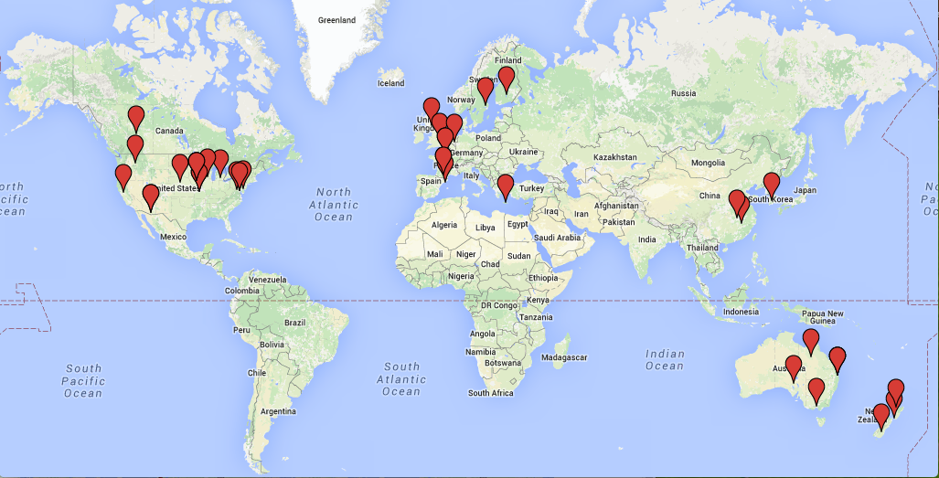
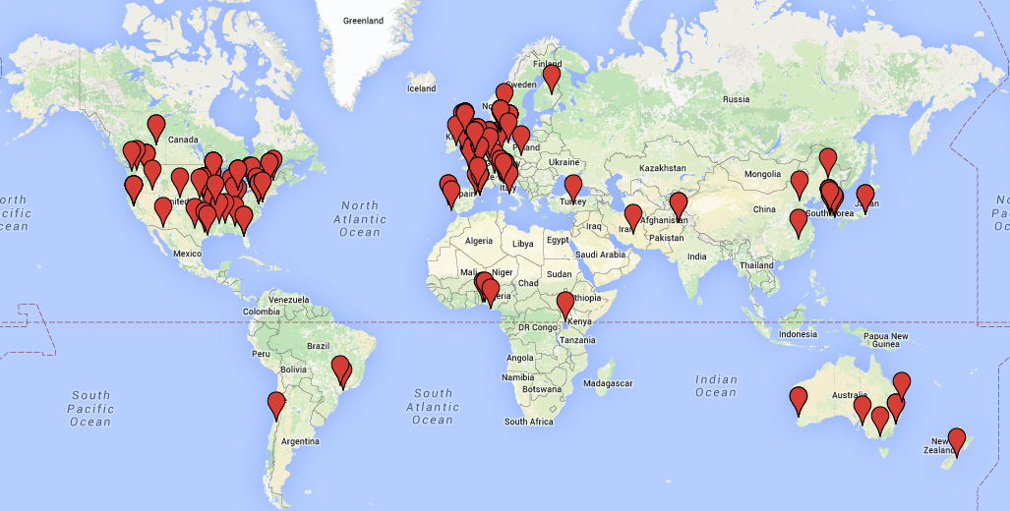
Brief history of FAANG
Organic growth of FAANG during 2015 current membership = 241
Genome Biology paper authors
Current membership

Slide 9
Purposes of FAANG: What are we all talking about?
Hypothesis:
Understanding animal genomes is a powerful means to learn about biology and solve societal problems
As the bioinformaticist would say:
“moving biology from stamp-collecting to physics”
- from descriptive to predictive biology
Notes:
Traditional scientific meeting goals

Slide 10
Value of Predictive Biology or “Genome to Phenome”
Predictive biology will allow us to:
Understand biological mechanisms
Improve phenotypes important in generating food and fiber
Improve models for human medicine
FAANG proposes to contribute to all these
Notes:
Traditional scientific meeting goals

Slide 11
What is the value of using Domesticated Animal genomics in Predictive Biology?
Strengths:
Huge phenotypic data on quantitative traits including domestication and selection
Long history in applying quantitative approaches to biology
Opportunities:
Animal genomes are now available
Ready for next stage
Notes:
Traditional scientific meeting goals

Slide 12
Genotypes and Phenotypes- BigData in domesticated animal research
SNP chip used* | Previous 4 years | Previous 15 months
BovineHD | 255,000 | 65,000
BovineLD | 451,000 | 266,000
PorcineLD | 220,000 | 135,000
PorcineHD | 110,000 | 34,000
OvineLD | 12,000 | 5,500
OvineHD | 21,000 | 6,000
CanineHD | 22,000 | 7,800
EquineHD | 14,000 | 7,500
MouseHD | 36,000 | 12,500
GoatHD | 2,600 | 1,600
FelineHD | 5,000 | 600
ChickenHD | 165,000 | 160,000
Fish | 16,000 | 16,000
Total | 1,329,600 | 717,500
*Data from ONE genotyping company in the United States….
Notes:
Beyond a traditional scientific meeting…..
We need to answer:
What do we bring to the table of global genomics research?
Why domesticated animals? (document deep phenotypes and genotypes); i.e., why not humans (New Nature Methods paper on deep human phenotyping…
We bring a strong statistical culture, deep data in controlled environments, but also diverse environments, even ocean… we bring comparative datasets on common phenotypes. – we bring ability to control environment… we bring the effect of domestication versus natural populations… we bring ability to control challenge to study of host-pathogen relationships in outbred populations and in field conditions.

Slide 13
Genotypes and Phenotypes- BigData in domesticated animal research - genome re-sequencing has also started
Species | Individuals Sequenced
Bos taurus | 3,000
Sus scrofa | 500
Gallus gallus | 500
Meleagris gallopavo | 170
Huge power in sequencing founders of pedigreed populations- imputation of all variants using SNP data
Notes:
Beyond a traditional scientific meeting…..
We need to answer:
What do we bring to the table of global genomics research?
Why domesticated animals? (document deep phenotypes and genotypes); i.e., why not humans (New Nature Methods paper on deep human phenotyping…
We bring a strong statistical culture, deep data in controlled environments, but also diverse environments, even ocean… we bring comparative datasets on common phenotypes. – we bring ability to control environment… we bring the effect of domestication versus natural populations… we bring ability to control challenge to study of host-pathogen relationships in outbred populations and in field conditions.

Slide 14
Genotypes and Phenotypes- BigData in domesticated animal research
Summary for 6 species:
1,515 publications
1,749 phenotypes
57,414 QTL
Notes:
Beyond a traditional scientific meeting…..
We need to answer:
What do we bring to the table of global genomics research?
Why domesticated animals? (document deep phenotypes and genotypes); i.e., why not humans (New Nature Methods paper on deep human phenotyping…
We bring a strong statistical culture, deep data in controlled environments, but also diverse environments, even ocean… we bring comparative datasets on common phenotypes. – we bring ability to control environment… we bring the effect of domestication versus natural populations… we bring ability to control challenge to study of host-pathogen relationships in outbred populations and in field conditions.

Slide 15
Examples of BigData in domesticated animal research- strong collaboration of academia and industry
Porcine Reproductive and Respiratory Syndrome (PRRS) virus
Feed efficiency
Bovine respiratory disease
Sequence-based genomic selection
Notes:
Beyond a traditional scientific meeting…..
We need to answer:
What do we bring to the table of global genomics research?
Why domesticated animals? (document deep phenotypes and genotypes); i.e., why not humans (New Nature Methods paper on deep human phenotyping…
We bring a strong statistical culture, deep data in controlled environments, but also diverse environments, even ocean… we bring comparative datasets on common phenotypes. – we bring ability to control environment… we bring the effect of domestication versus natural populations… we bring ability to control challenge to study of host-pathogen relationships in outbred populations and in field conditions.

Slide 16
PRRS as an example of BigData in domesticated animal research
Over 3,600 outbred animals challenged and genotyped with 30,000+ samples phenotyped
One genetic locus controlling tolerance to virus identified and transcriptional response networks found
Next level → functional analyses to identify predictors of tolerance and resistance
Notes:
Beyond a traditional scientific meeting…..
We need to answer:
What do we bring to the table of global genomics research?
Why domesticated animals? (document deep phenotypes and genotypes); i.e., why not humans (New Nature Methods paper on deep human phenotyping…
We bring a strong statistical culture, deep data in controlled environments, but also diverse environments, even ocean… we bring comparative datasets on common phenotypes. – we bring ability to control environment… we bring the effect of domestication versus natural populations… we bring ability to control challenge to study of host-pathogen relationships in outbred populations and in field conditions.

Slide 17
Purposes of GO-FAANG: What are we trying to accomplish here?
Foster further collaboration in FAANG research
Document progress and scientific needs in understanding of animal genomes
Lay a foundation for expansion of FAANG opportunities.
Notes:
Traditional scientific meeting goals

Slide 18
Purposes of GO-FAANG: What is the plan?
Tonight: setting the stage
Plenary talk on “how it’s done”
Thursday morning:
Plenary talks on “Data use” and “Data analysis”
Talks by FAANG organizers on our progress
Funding agency perspectives

Slide 19
Purposes of GO-FAANG: What is the plan?
Thursday afternoon:
Two breakout sessions to continue discussion, get feedback, and identify future steps
Wrap-up
Reporting back
Summary of discussion, plans for the future

Slide 20
Purposes of GO-FAANG: How will we measure success?
Publication of Workshop outcomes
Plans for improving:
collaborative research
FAANG infrastructure
Continued dialog
Follow-up meetings: 4 planned over next 2 years
Expansion of FAANG Research and Its Impacts

Slide 21
Your charge
Active participation at GO-FAANG!
Challenge the speakers!
Join in the conversations at breakout sessions!
Provide suggestions for moving forward!
Active participation in the future!

