Slide 1
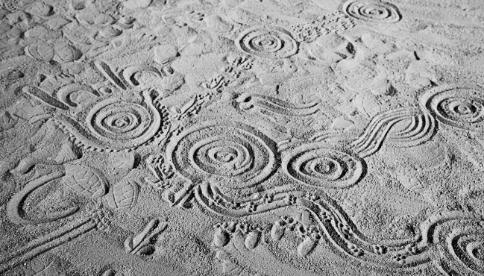
A biologist’s mud-map of genome projects
Christine Wells
c.wells@uq.edu.au
Christine.wells@glasgow.ac.uk

Slide 2
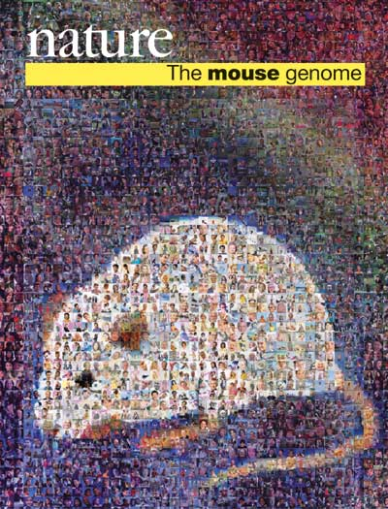

The Genomic era:
Understanding phenotypes and phenotypic variation

Slide 3
The genomics challenge:
  Gene Content
  Genotype
  Integrating context:
    gene expression data
    gene regulatory information
    biological pathways
DNA
RNA, Protein (most labile)
Phenotype
Chromatin
environment
Build gene networks predictive of phenotype

Slide 4



The challenge of Genome Projects.
Facts are not science - as the dictionary is not literature.
Martin H. Fischer
A pile of bricks is no more representative of a house, than a pile of ‘omics data is representative of biology
The RNA world
Are these too small
Too hard to discriminate
And too common
To be doing anything important?

Slide 5
The three principals for making sense of Systems-scale data
  Emergence: gaining insight from omics data.
  Modularity: finding networks and pathways
  Robustness: understanding network properties
In practical terms, we must resource:
1/ generation of quality data
2/ tools for visualization, integration and sharing of data
3/ collaboration between bioinformatics, biostatistics and biologists to mine the data

Slide 6
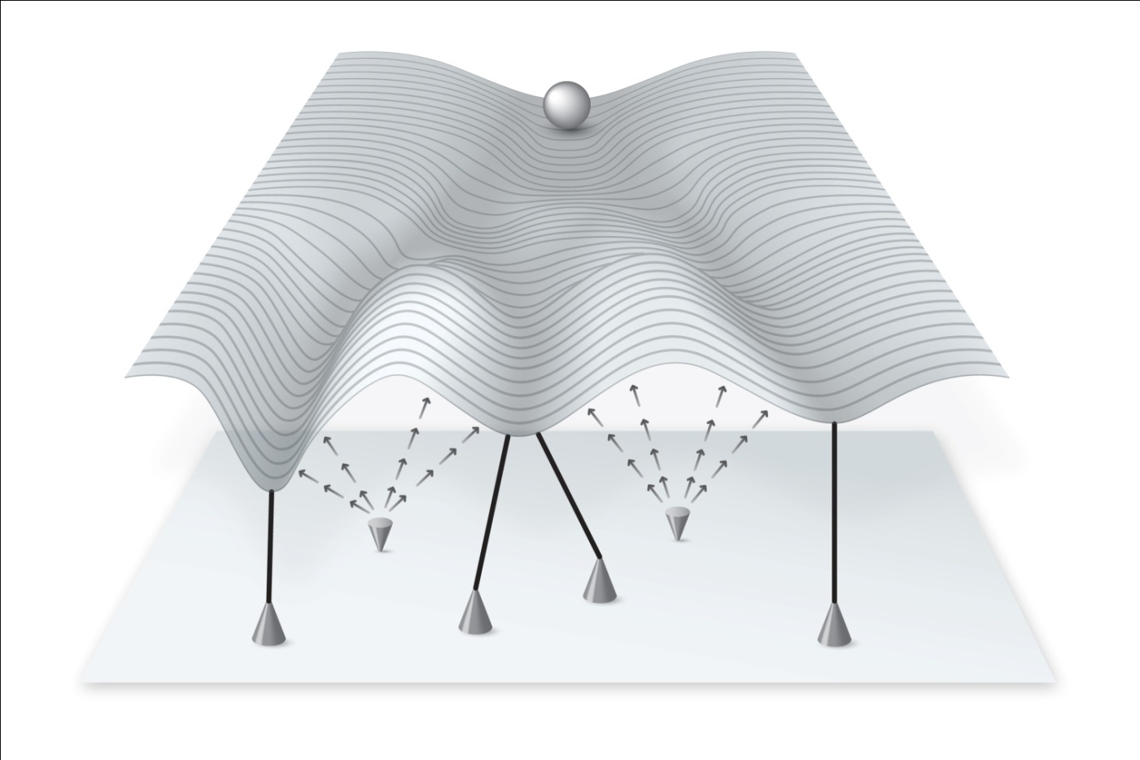
Robustness refers to the predictability of a phenotypic outcome in the face of genetic and environmental perturbation
It is essential to find metrics that describe robustness: These are the metrics that will allow us to test how generalizable our models are, and the applicability of our observations to complex traits.
Canalized traits
Constrain the range of phenotypes

Slide 7



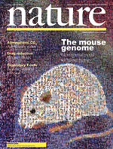
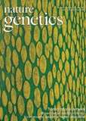


FANTOM
The importance of atlas projects:
2001-2005
Functional Annotation of the Mammalian Genome
2006-2009
2014
An atlas of human promoters and enhancers
2015
Active enhancers at the leading edge of cell state transition

Slide 8
The FANTOM structure
Bioinformaticians, Biostatisticians, Computational biologists
GENOME
BIOLOGY
SYSTEMS
BIOLOGY
RIKEN Genome Sciences Group
-technology development,
Computational infrastructure
Project coordination
STRATEGISTS
Sample providers: Experts in one particular biological domain
Embargoed access to data
Comparative power of larger atlas

Slide 9
The FANTOM structure
Sample providers:
->Struggle to find/use/visualize data in the absence of embedded bioinformatics.
-> May have unrealistic expectations of the project, project support and outcomes.
-> Need to be proactively engaged.
<- Frame the biological context, frame relevant biological questions.
-> Analysis focus is often on a gene, gene network/pathway.
-> Interested in functional validation
– lengthy and expensive and difficult en masse.
<-STRONGEST LINK to PHENOTYPE.

Slide 10
The FANTOM structure
Bioinformatics and computational biology:
-> Sandpit approach
-> Agreed terms of “mutual respect”
->value in redundancy of effort
-> danger in computational silos.
Opportunity to form close and productive collaborations
Danger of ‘food-court bioinformatics’
Need help framing the right questions
Will experience a range of computational rigor/quality: standards need to be agreed
Opportunity to form deep domain expertise in specialist data types

Slide 11
The FANTOM structure
Strategy group
-> Drawn from all layers of the project
-> individuals with broader vision/ generalist interests
-> interested in developing underlying rules of systems behaviours
-> good communicators
-> meet frequently, plan publications and recruit into publication tasks.
GENOME
BIOLOGY
SYSTEMS
BIOLOGY
STRATEGISTS

Slide 12
FANTOM
The importance of atlas projects:
2001-2005
Functional Annotation of the Mammalian Genome
2006-2009
2014
An atlas of human promoters and enhancers
2015
Active enhancers at the leading edge of cell state transition

Slide 13

The importance of atlas projects (i)
Expand our view of the genome
Set out to catalogue a representative mRNA for every protein-coding gene
Built the computational infrastructure for Gene-discovery, ORF annotation
Yoshihide Hayashizaki
Analysis of the mouse transcriptome based on functional annotation of 60,770 full-length cDNAs. Nature 420,563-73 (2002).
The Transcriptional Landscape of the Mammalian Genome. Science 2005, 309(2):1559-1563
Transcript annotation in FANTOM3: mouse gene catalog based on physical cDNAs. PLoS Genetics 2006, 2(4):e62.

Slide 14
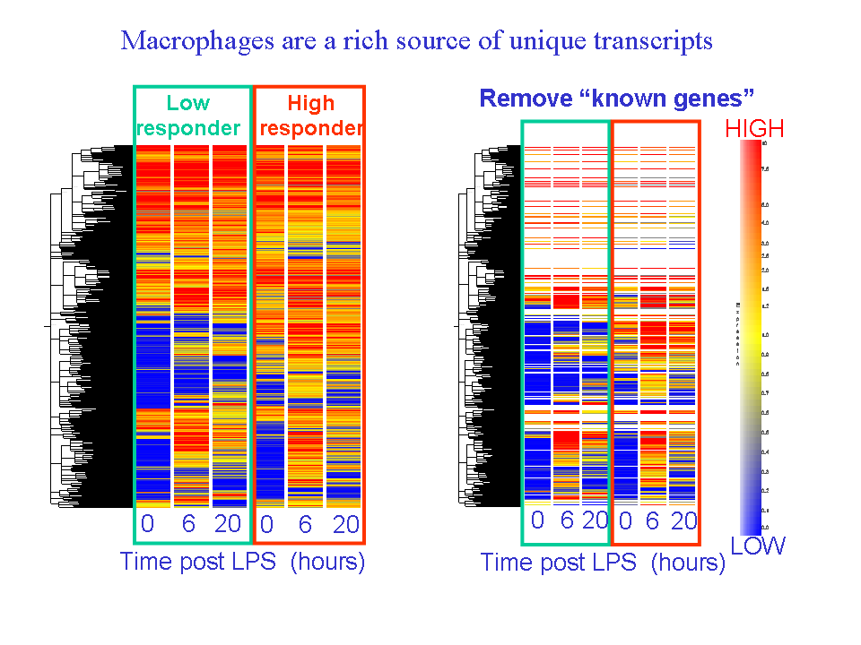
Gene discovery in macrophages
Wells, C. A., et al. (2003). Continued Discovery of Transcriptional Units Expressed in Cells of the Mouse Mononuclear Phagocyte Lineage. Genome Res. 13(6b): 1360-1365.

Slide 15
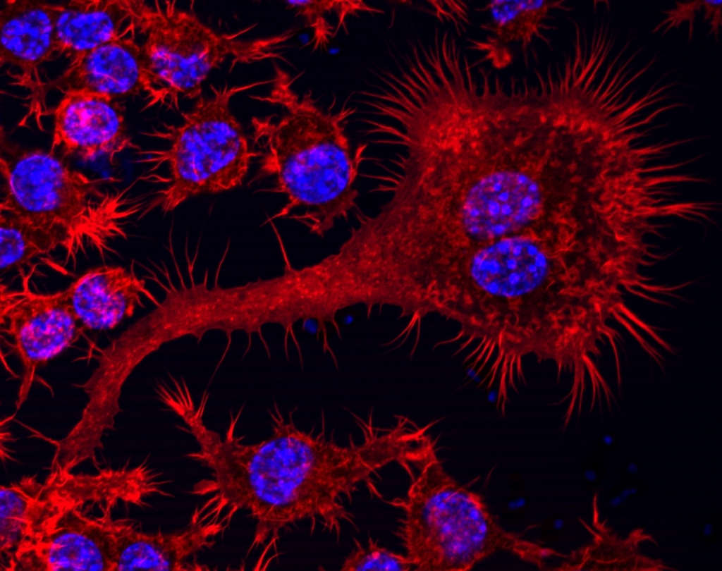
Transcript-based gene models
Many transcripts transient
Enumerate members of protein classes
Important to include breadth of cell types

Slide 16
The importance of atlas projects (i)
Expand our view of the genome
Set out to catalogue a representative mRNA for every protein-coding gene
Built the computational infrastructure for Gene-discovery, ORF annotation
The Transcriptional Landscape of the Mammalian Genome. Science 2005, 309(2):1559-1563
Antisense transcription in the mammalian transcriptome.
Science 2005, 309(2):1564 -1566.
First (unexpected) glimpse of noncoding RNA world.

Slide 17
The importance of atlas projects (ii)
Collate unbiased descriptions of genome architecture and genome evolution
Complex Loci in Human and Mouse Genomes.
PLOS Genetics 2006 2(4):e47.
->Noncoding RNA major product from RNA Pol II
-> Phenomenology or new functional molecular class?
-> required integration of many layers of evidence
-> New technology development to directly measure TSS
Genome-wide analysis of mammalian promoter architecture and evolution. Nature Genetics 2006, 38(6):626-635.

Slide 18

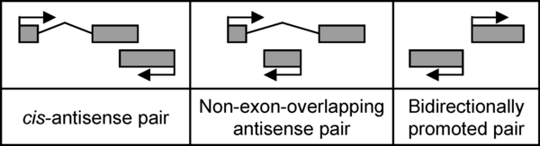

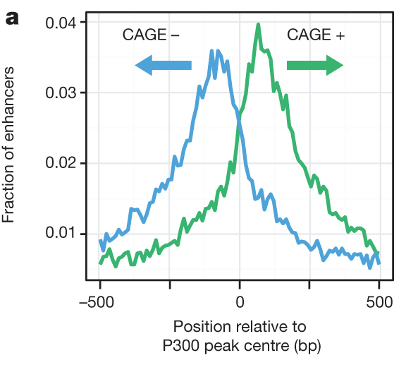

Engström PG, Suzuki H, Ninomiya N, Akalin A, Sessa L, et al. (2006) Complex Loci in Human and Mouse Genomes. PLoS Genet 2(4): e47. doi:10.1371/journal.pgen.0020047
http://127.0.0.1:8081/plosgenetics/article?id=info:doi/10.1371/journal.pgen.0020047
LncRNA
PROMPTs
miRNA
eRNAs
Piero Carninci
R Andersson et al. Nature 507, 455-461 (2014) doi:10.1038/nature12787

Slide 19
The importance of atlas projects (iii)
Build generalizable observations
Occasionally define new ‘rules’
Transcribed Enhancers lead waves of coordinated transcription in transitioning mammalian cells (2015) Science 347 (6225), 1010-1014

Slide 20

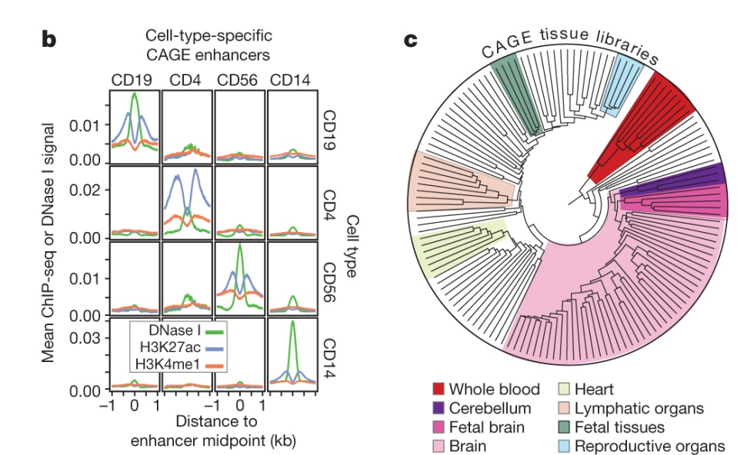

CAGE expression identifies cell-type-specific enhancer usage.
Albin Sandelin
Robin Anderssen
R Andersson et al. Nature 507, 455-461 (2014) doi:10.1038/nature12787

Slide 21
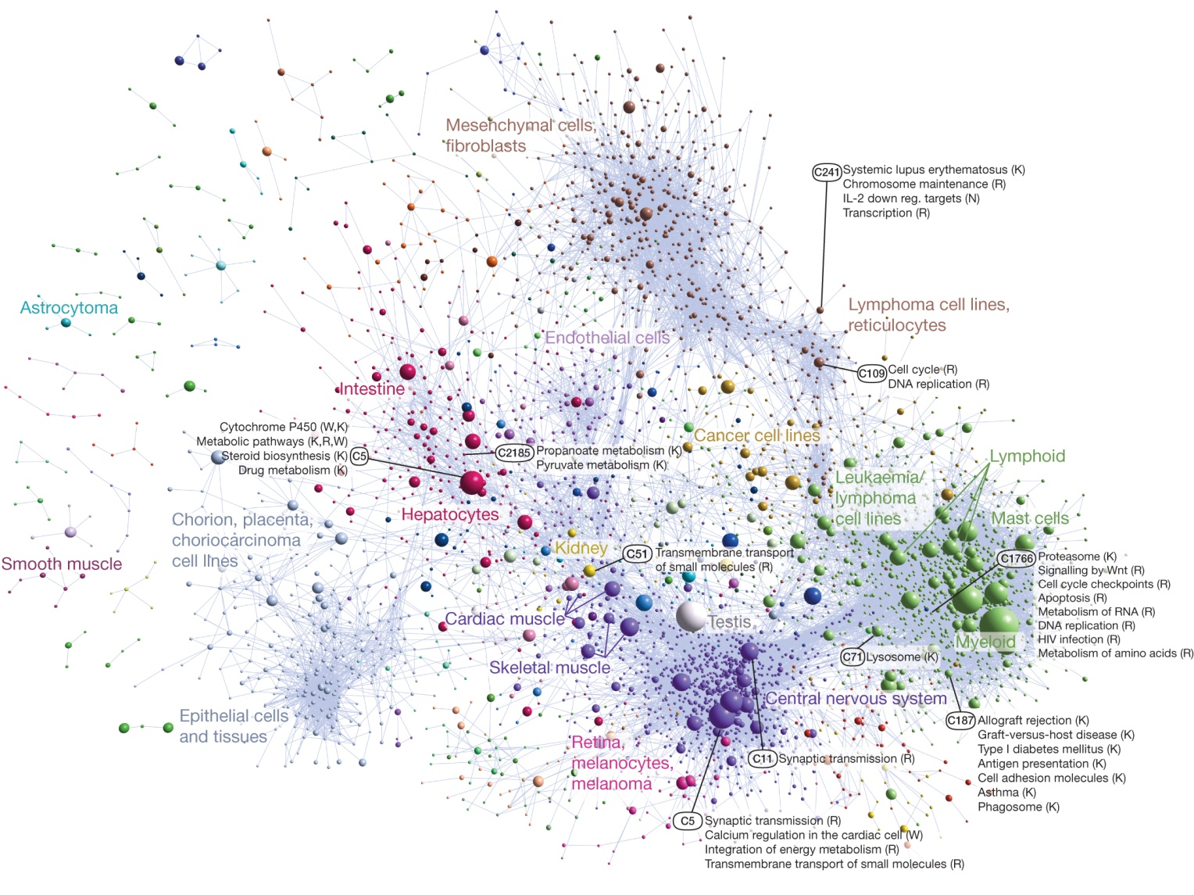
Networks are tissue-specific:
Coexpression clustering of human promoters in FANTOM5.
Fig. 4: ARR Forrest et al. Nature 507, 462-470 (2014) doi:10.1038/nature13182
Notes:
Modules may be comprised of different forms of a gene, mRNA or protein isoform, but the rules of interaction within that module will be conserved. It helps to know which module, and then the specific components of that module in terms of tissue/cell/disease relevance.

Slide 22
The importance of atlas projects (iv)
Increase power and potential of molecular phenotypes
help us find useful surrogates for chromatin behaviour
Help us understand complex biology

Slide 23
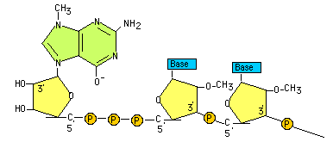
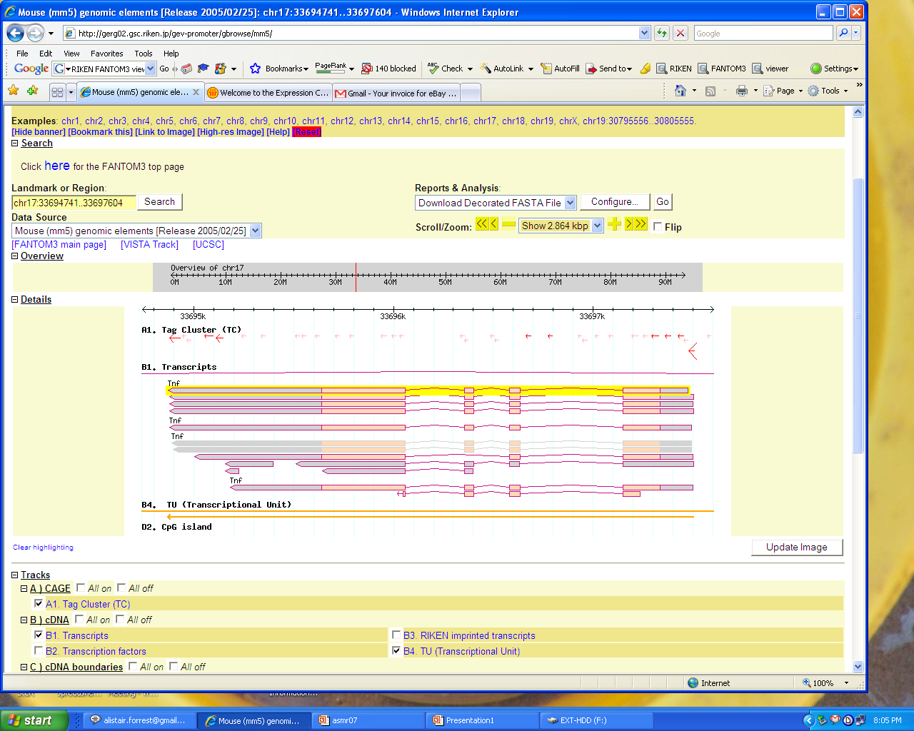

Capped Analysis of Gene Expression: CAGE
Single molecule Helicos sequence
Quantitative
Reproducible
Promoter level expression atlas on 1059 human samples
5

Slide 24
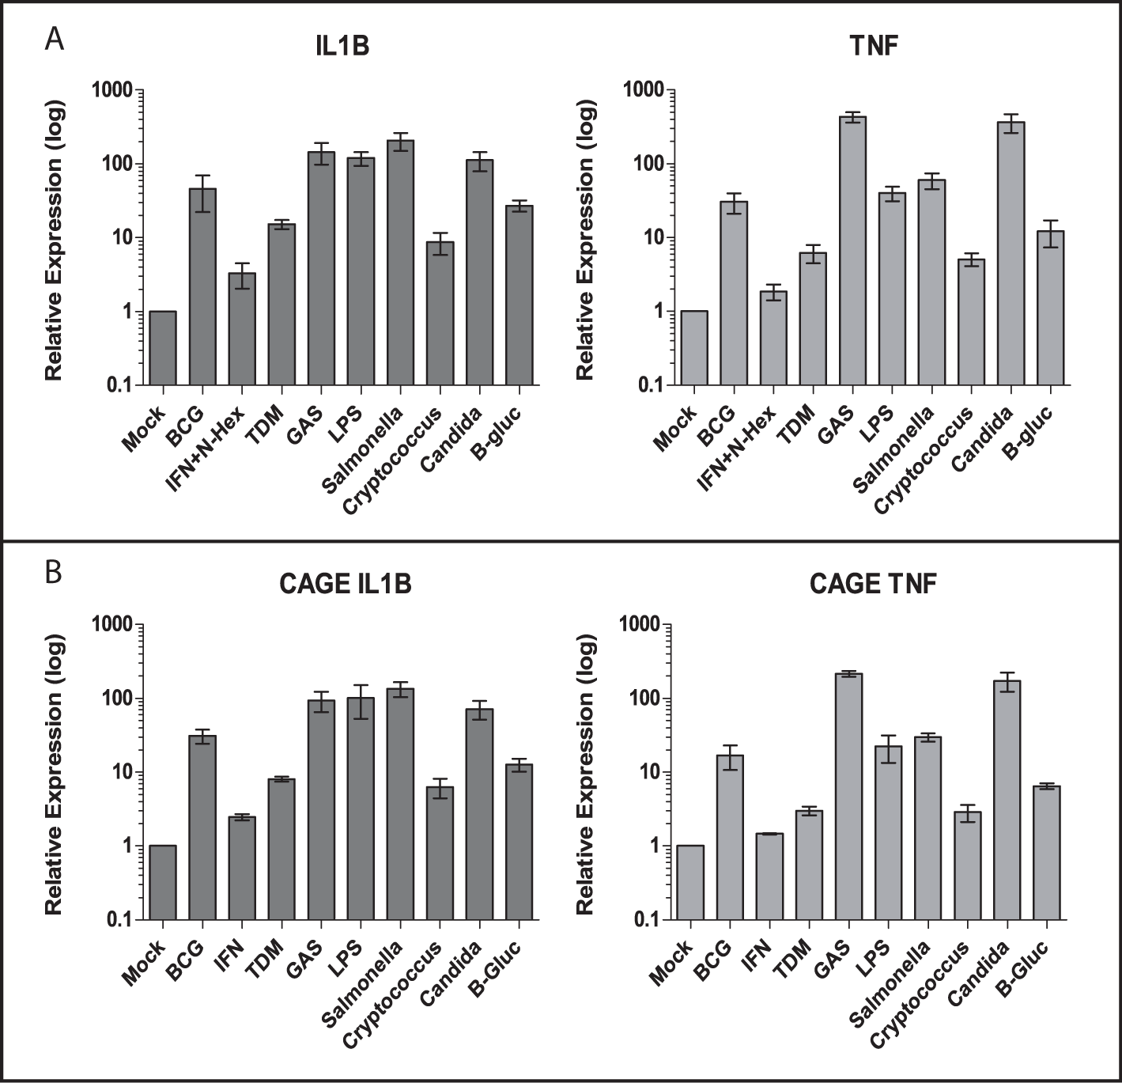
CAGE is a quantitative measure of gene expression
PCR
n=6 donors
CAGE
n=3 donors

Slide 25
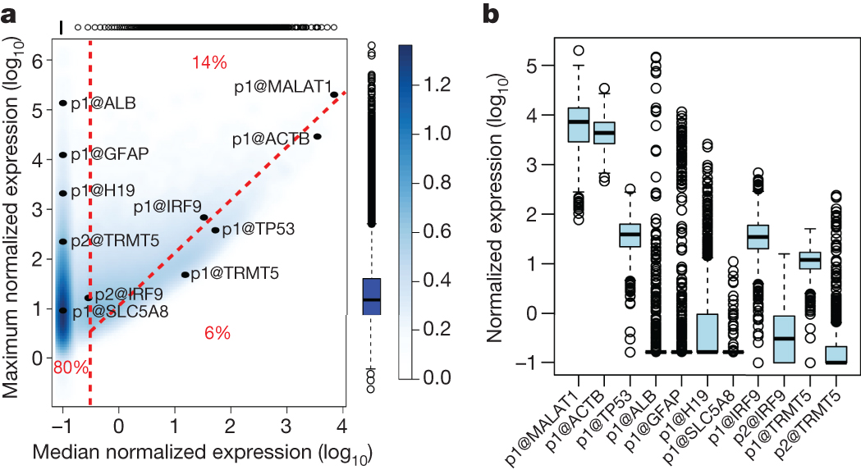
Few genuine “housekeeping” transcripts encoded in themammalian genome.
ARR Forrest et al. Nature 507, 462-470 (2014) doi:10.1038/nature13182

Slide 26
Mycobacterium Bovis
TDM
C. Albicans
GAS
Salmonella
LPS
Cryptococcus
BGlucan
Mock

Slide 27
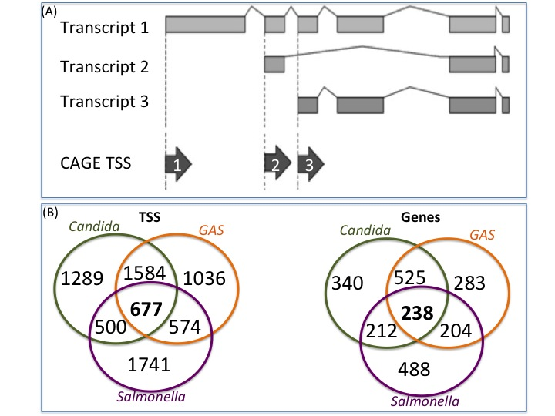
Innate genes <transcripts

Slide 28
Gene expression from resting monocytes produces multiple transcripts
42%
58%

Slide 29
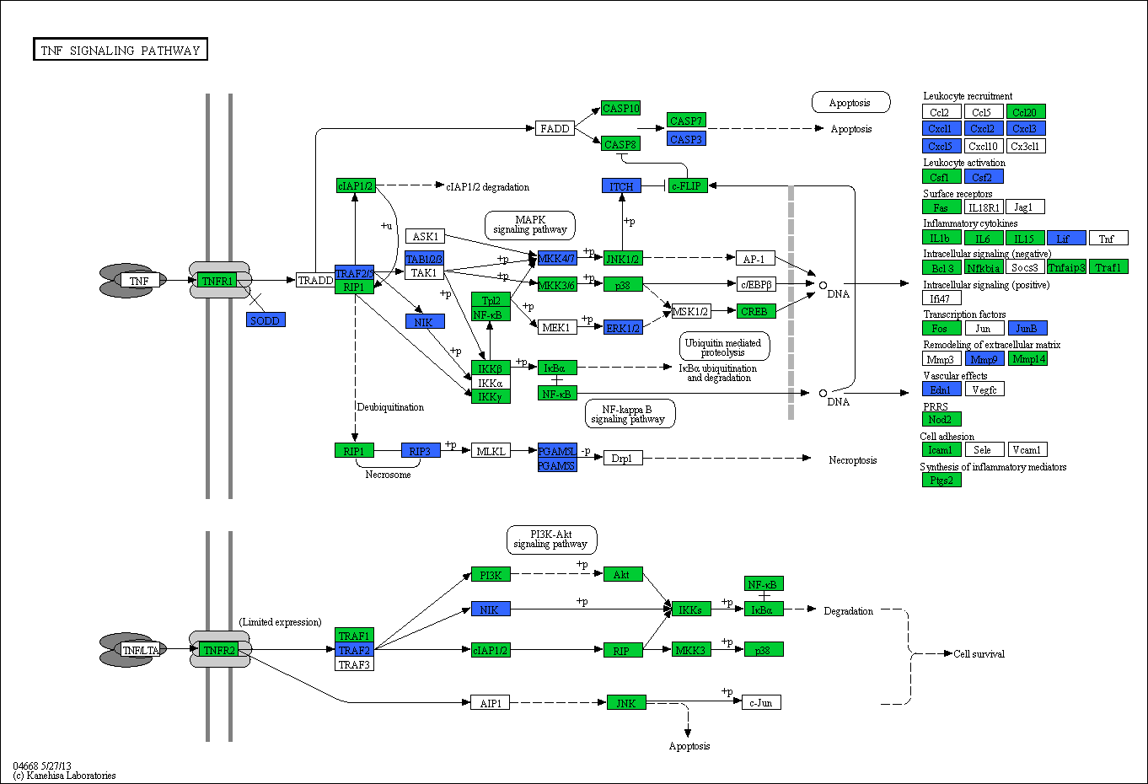
Genes expressed from one TSS
Genes expressed from multiple TSS

Slide 30
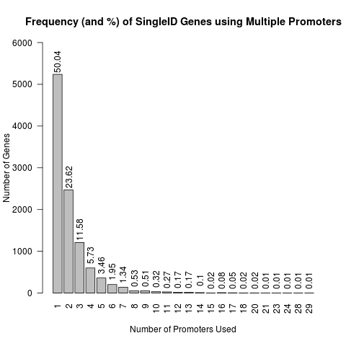
Most inducible genes are multi-transcript
Number of TSS per gene
32%
68%

Slide 31
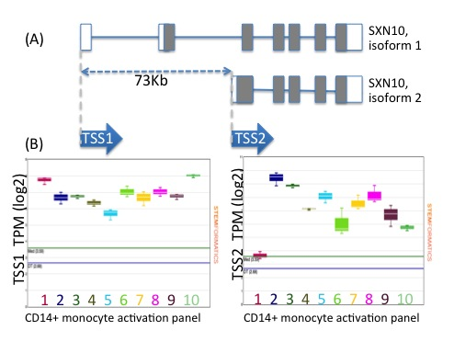
Sorting Nexin 10 Δ TSS alters N-terminal

Slide 32
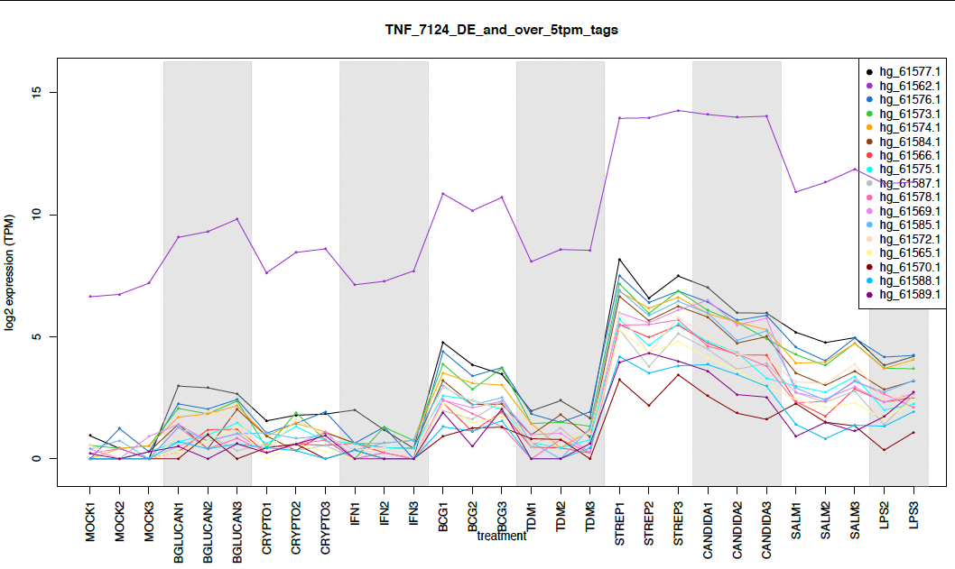
Convergent signaling amplifies transcription from some cytokines
TNF

Slide 33
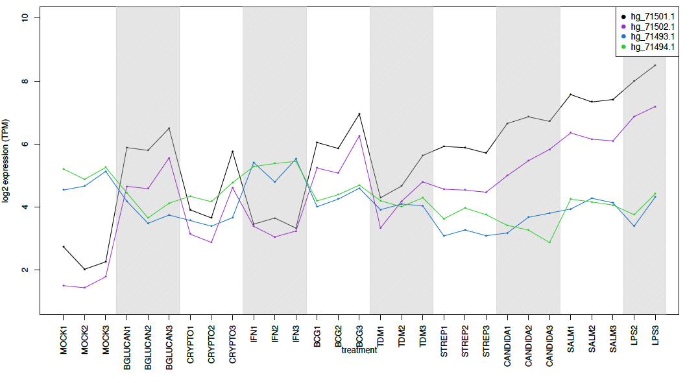
Pathogen specific signaling drives different gene products
BCL3

Slide 34
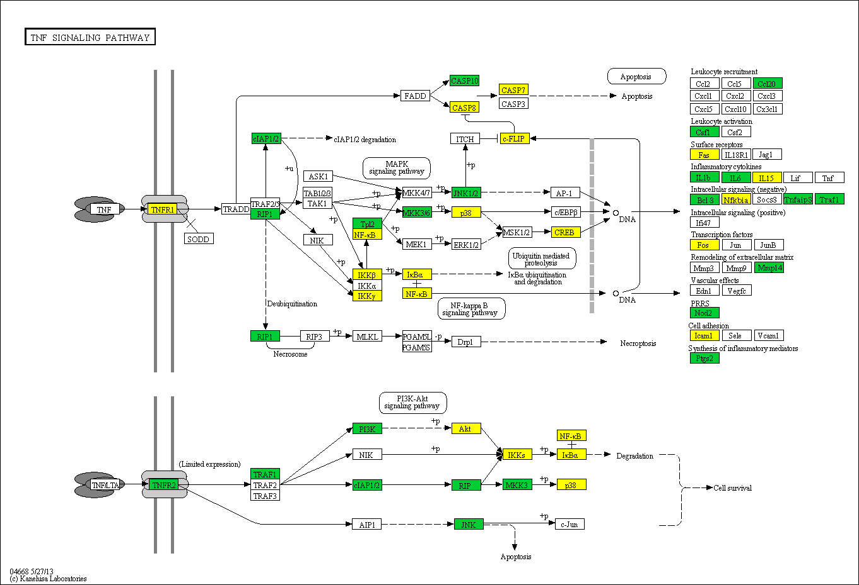
Genes expressed from multiple TSS
Multi-TSS genes where TSSs drive
potentially different proteins

Slide 35
Alternate Transcription initiation rapidly alters transcript function
In an immune context -> rapid diversification of innate immune outputs.
Rapid switch between coding and noncoding
Altered 3’UTR
Isoform swapping
Rapid gain/loss of N-terminal domains
  Signal peptides
  Trans-membrane domains
  PPI domains

Slide 36
A new RNA ontology?
A rethink about enhancer/promoter terminology? New definitions of a gene?
Integrating ideas on phenotype expressivity/penetrance
Static vs transitioning genome.

Slide 37




Acknowledgements
www.stemformatics.org
AIBN
Wells Group
Edward Huang
Suzanne Butcher
Florian Rohart
Elizabeth Mason
Nick Matigian
Barbara Rolfe
Sylvia Manzanero
Stemformatics/3iii
Rowland Mosbergen
Othmar Korn
Tyrone Chen
Shane Kelly
Past lab members
Anthony Beckhouse
Kelly Hitchens
Dipti Vijayan
Mark Walker
Mikael Boden
Matt Sweet
James Fraser
Antje Blumenthal
Tim Barnett
Lisa Seymour
Nilesh Bokil
Eve Chow
Jess Mar
HSPH/Dana
John Quackenbush
Al Forrest
Michael Rehli
Albin Sandelin
Piero Carninci
Carsten Daub
Hideya Kawaji
Winston Hide
Yoshihide Hayashizaki
3iiiformatics
Rowland Mosbergen
Othmar Korn
Tom Muir
Tyrone Chen
Funding from Australia: Research Council, NHMRC, QLD Government
UK: MRC, Wellcome trust and Arthritis UK

