Slide 1
FAANG Data Coordination Centre
Submitting and Retrieving Rich Datasets
PAG, 2019
Peter Harrison
Data Coordination and Presentation Project Lead
EMBL-European Bioinformatics Institute
peter@ebi.ac.uk
@peterwharrison

Slide 2
FAANG Data Coordination Centre
Coordinated international effort to provide high quality functional annotation of animal genomes with a focus on the livestock community to create a rich genome to phenome resource.
Ensuring data is richly described, available and searchable.
Ensuring data is consistently reported and presented.
Support standardisation of protocols and analysis methods.
Facilitating data openness, reusability and cross-project analysis.
Notes:
From a data perspective core aims

Slide 3
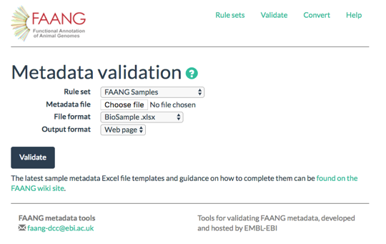
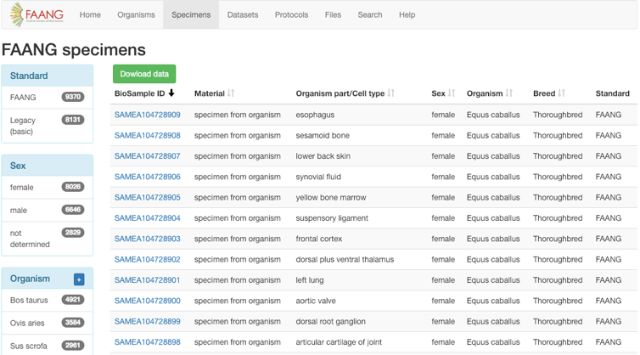
FAANG Data Coordination Centre
Implement the metadata rules from the FAANG Metadata and Data Sharing committee, that Carl and I chair.
Provide tools to support depositors in meeting these standards and submitting data to public archives.
Provide data coordination support: faang-dcc@ebi.ac.uk
Build and maintain the data portal: http://data.faang.org

Slide 4
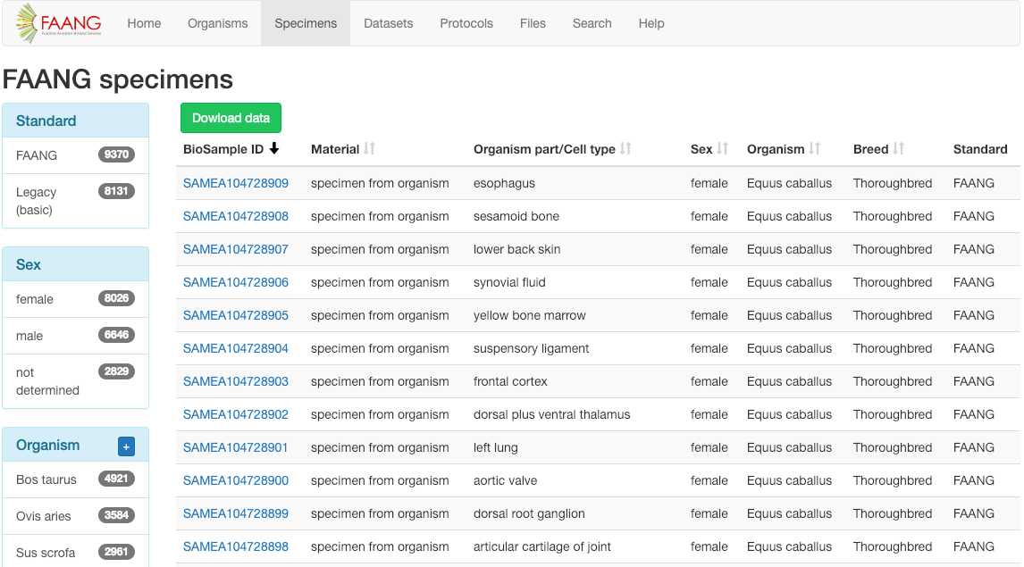
FAANG Data portal
Single access point for all FAANG data.
Richly described data enables powerful filters to narrow down to data of interest.
Full support for programmatic access through API, see help pages for instructions.
Now import legacy data, 387 datasets thus far.
http://data.faang.org/

Slide 5
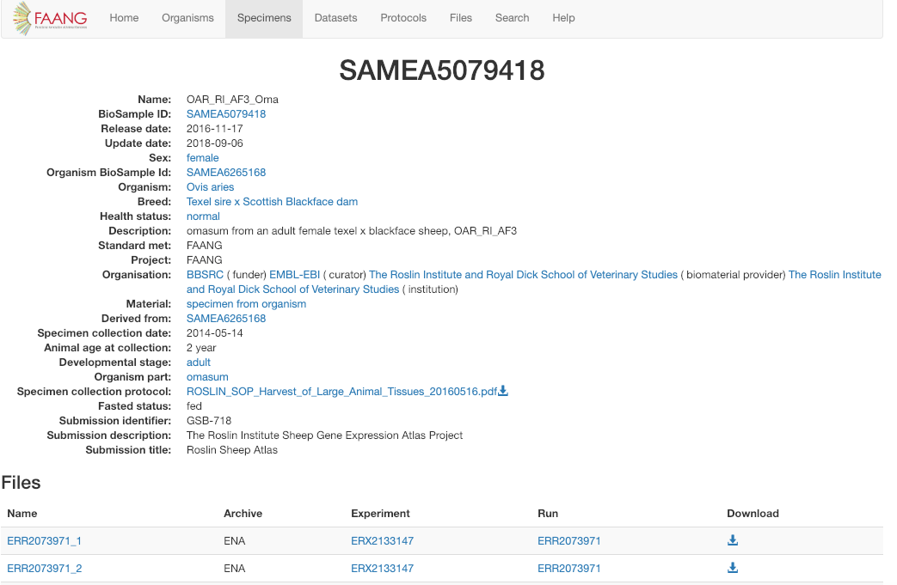
FAANG Data portal
Individual detail pages provide full metadata, to ensure data matches your requirements and is comparable to other sets.
Each record provides access to sample and experiment protocols.
Download any data files associated with the sample with direct links to data in archives.
http://data.faang.org/

Slide 6
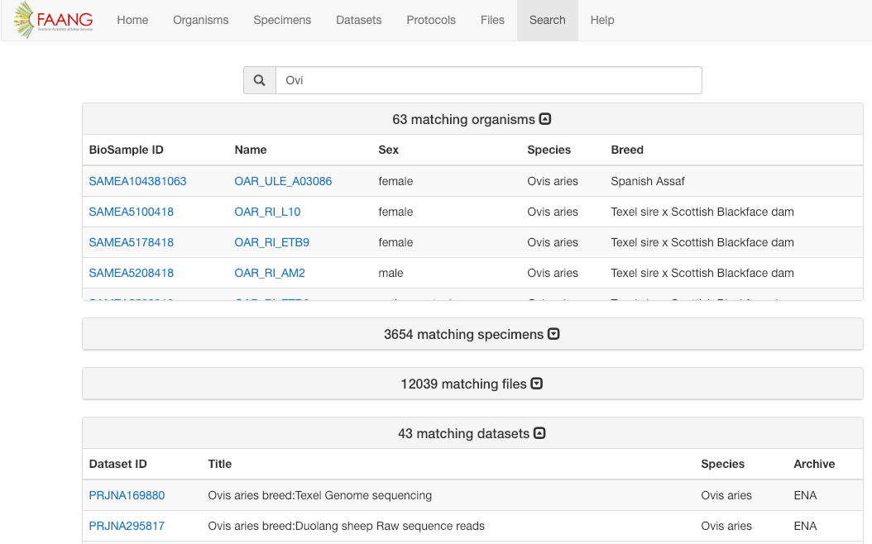
FAANG Data portal search
Predictive text based search across all FAANG metadata fields.
Returns organisms, specimens, datasets and individual analysis files.
Search results link to individual detail pages.
Legacy filter option coming soon.
http://data.faang.org/search

Slide 7
What FAANG data is already available
9370 samples from 416 organisms across 8 species.
19 publicly available richly described datasets indexed thus far comprising 16,114 downloadable files including:
transcription profiling by high throughput sequencing, methylation profiling,
ATAC-Seq, RNA-Seq, microRNA profiling, Dnase-hypersensitivity & Hi-C.
1887
1446
1263
2581
210
954
693
336
http://phylopic.org/

Slide 8
What makes the FAANG collection special
Rich, consistent and validated metadata data descriptions.
Standardised core assays from contributing projects.
Mandatory sampling and experiment protocols connected to each dataset available with the data for download.
FAANG working groups moving towards standardised analysis pipelines and protocols.
To accelerate genome to phenome research

Slide 9
The FAANG metadata solution
The FAANG Metadata and Data Sharing Committee set out to richly describe samples and experiments:
Comprises 118 different metadata questions
66 sample attributes (Organisms, Specimens, pools of specimens, cell cultures, cell lines).
52 experiment attributes (Chip-Seq, RNA-Seq, ATAC-Seq, Hi-C, WGS, Dnase-Seq, BS-Seq).
https://www.ebi.ac.uk/vg/faang/rule_sets/
Notes:
Are currently writing a new metadata standard for analysis objects.

Slide 10
The FAANG data model
Separately register animals, samples and experiments and analyses.
Organism
SAMEA6265168
http://phylopic.org/

Slide 11
The FAANG data model
Separately register animals, samples and experiments and analyses.
SAMEA103886757
Organism
SAMEA6265168
Specimens
SAMEA5079418
Cell cultures
Cell lines
SAMEA104728849
http://phylopic.org/

Slide 12
The FAANG data model
Separately register animals, samples and experiments and analyses.
Assay data files
RNA-Seq
ERR2073971
ATAC-Seq
ERR2611825
SAMEA103886757
Organism
SAMEA6265168
Specimens
SAMEA5079418
Analyses
BAMs
VCFs
VEP
Cell cultures
Cell lines
SAMEA104728849
http://phylopic.org/

Slide 13
Metadata standard aims to
be fully understood, repeatable and reusable.
use consistent terminology.
be well structured, rich and specific.
Terminology controlled through standardised ontologies to make downstream search and analysis more powerful.
Enhancing reproducibility, accelerating research and enabling cross-depositor analyses to be performed.
https://www.ebi.ac.uk/vg/faang/rule_sets/

Slide 14
Contributing data to FAANG
FAANG metadata is input to a spreadsheet template (or JSON for programmatic users).
Utilise the FAANG rule sets to know which fields are mandatory.
We control the values of each field, and will check them for you.

Slide 15
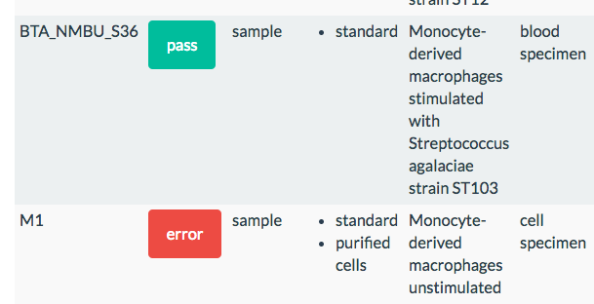
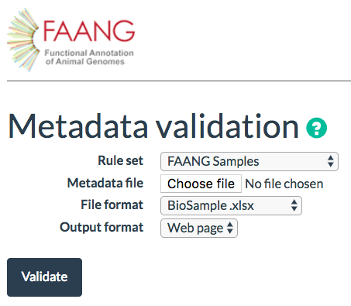
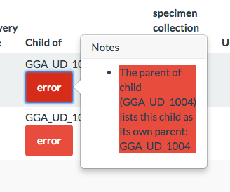
FAANG Metadata validation tools
https://www.ebi.ac.uk/vg/faang/validate/
Validation and conversion tooling to assist depositors in meeting the detailed FAANG metadata standards.
Depositors complete spreadsheet templates, validate them and convert to a format ready for archive submission.

Slide 16
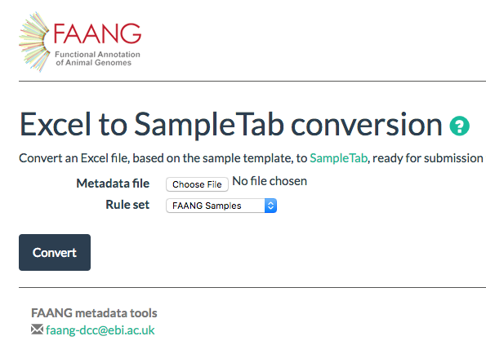
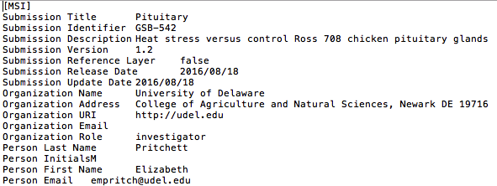
FAANG Metadata validation tools
FAANG system will also convert from your spreadsheet template to a version compatible with submission to the public archives at EMBL-EBI.
We tag your data as FAANG so that we can find it again.
On conversion, validates again and checks project information.
If passes, returns correctly formatted SampleTab for BioSamples and XML for ENA.

Slide 17
Supply the FAANG metadata with your archive submission
Submit metadata and data files to the public archive.
FAANG data portal will automatically detect them due to ‘FAANG’ tags.
Important to not submit directly to archives, need to validate metadata with FAANG standards (see data.faang.org).

Slide 18
Supply the FAANG metadata with your archive submission
All FAANG data should be in the FAANG data portal, so contact us if your data hasn’t been indexed faang-dcc@ebi.ac.uk
Organisms and samples should be separately submitted to the BioSamples database, before you submit any experimental assay data.

Slide 19
Current EMBL-EBI submission architecture
Sample
DNA
RNA
Study
MassSpec
Biochemical
Webin
EGA Subs
Annotare
Px Subs
BioSample Subs
ENA API
BioStudies Subs
Metabolight Subs
Bio
Samples
ENA
BioStudies
AE
Pride
Metabo
lights
EGA
EVA

Slide 20
EMBL-EBI’s submission system is changing, but it will be simpler
Sample
DNA
RNA
Study
MassSpec
Biochemical
User interface
API
Bio
Samples
ENA
EGA
EVA
BioStudies
AE
Pride
Metabo
lights

Slide 21
EMBL-EBI Unified Submissions Interface
Single submissions interface for 8 EMBL-EBI archives, same system for samples, experiments and analyses.
Built in validation system, will have all FAANG rulesets available.
Now available for general sample submissions, currently working on incorporating FAANG rulesets so that it can start to be used.
More robust system with user experience lead design.
Extensive training, documentation and help will be available.
http://data.faang.org

Slide 22
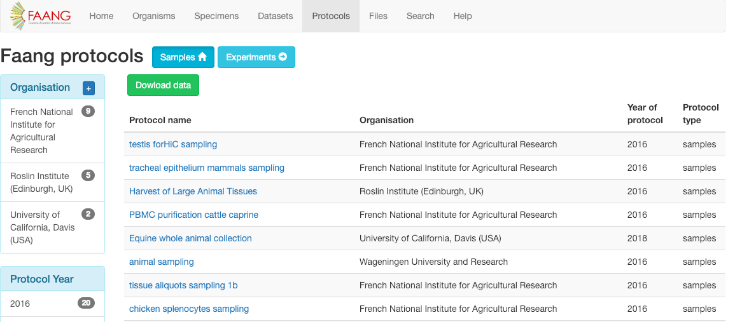
Recent update: New portal protocols pages
Easier to find sample and experimental protocols to assist in study design.
Filter by assay type, experimental targets and organisation.
Plan to host FAANG approved experimental protocols for different assay types from FAANG working groups when available.

Slide 23
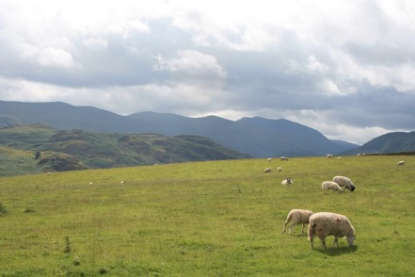
Planned developments
Full integration with new EMBL-EBI Unified Submissions Interface, support and training for FAANG members.
Trackhubs and ENSEMBL browser integration.
Further data portal user experience (UX) improvements.
Support for bulk file download.
Provide display view window of FAANG studies/consortiums by group and organism.
Hosting approved protocols and analysis workflows.
Programmatic access (API) improvements.
Photo: Peter Harrison
http://data.faang.org
Notes:
Really keen to hear from you what features would help support your research.

Slide 24
Join the community, share your data.
It accelerates research.
Improves global genome to phenome resources and builds.
Increases your citation rates and standing in the community.
Maximises value to public and charitable funding.
Increases impact of your research, fosters collaboration.
Stops wasteful duplication of data.
Promotes innovation through downstream and comparative analyses.
Benefit from a community of expertise in data analysis, protocols and workflows.
Funding benefits, including access and support in targeted calls from US and EU funding bodies.

Slide 25
Want to learn more about FAANG submission?
FAANG: Hands on metadata validation and data submission training workshop
16th January 1-5pm
Plant and Animal Genomes Conference San Diego.
To register: Email faang-dcc@ebi.ac.uk or ask me at the end of the workshop.
Course will be repeated at ISAG, Leida Spain on 12th July.
Registration for this opening soon.

Slide 26
Interested in joining FAANG? We are here to help with your data…
http://data.faang.org
faang-dcc@ebi.ac.uk
peter@ebi.ac.uk
Alexey Sokolov
Jun
Fan

